Slide 1
CEIS 150
Kaleb Bakken

Slide 2
Introduction
In this course we got more into a intermediate status of programming and for the projects itself we focused on being able to create coding done for stocks and being able to add, remove, update stocks and being able to bring current information pulled from the web, and all integrated into the code

Slide 3
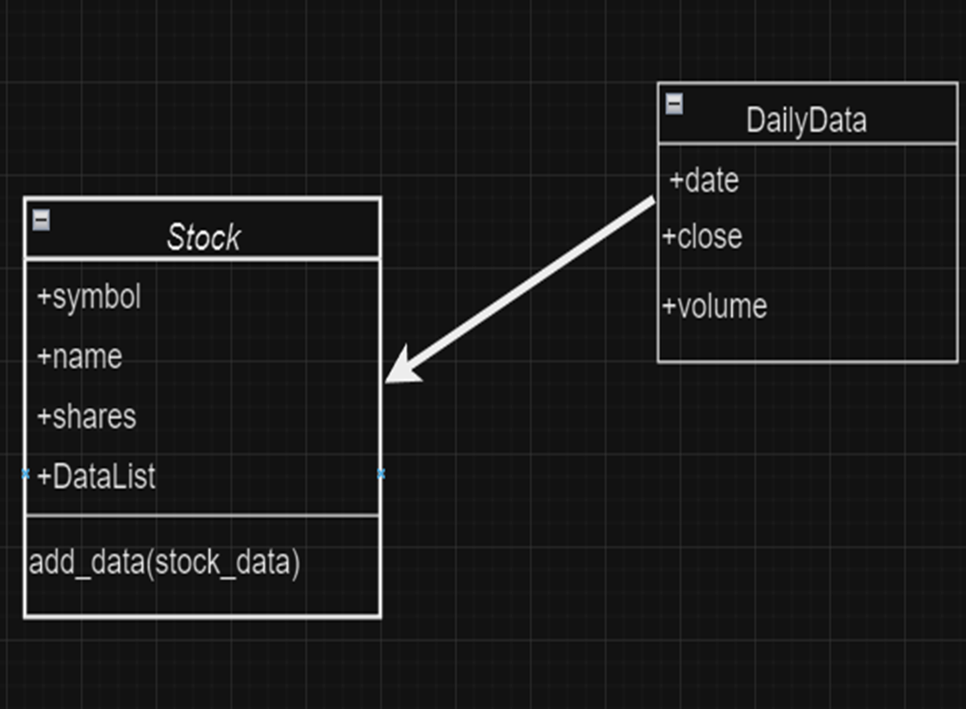
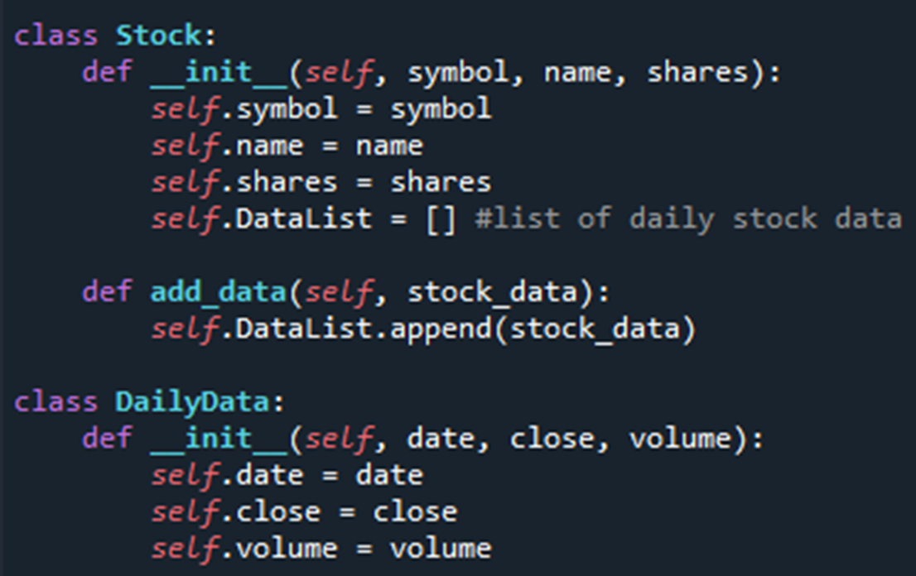
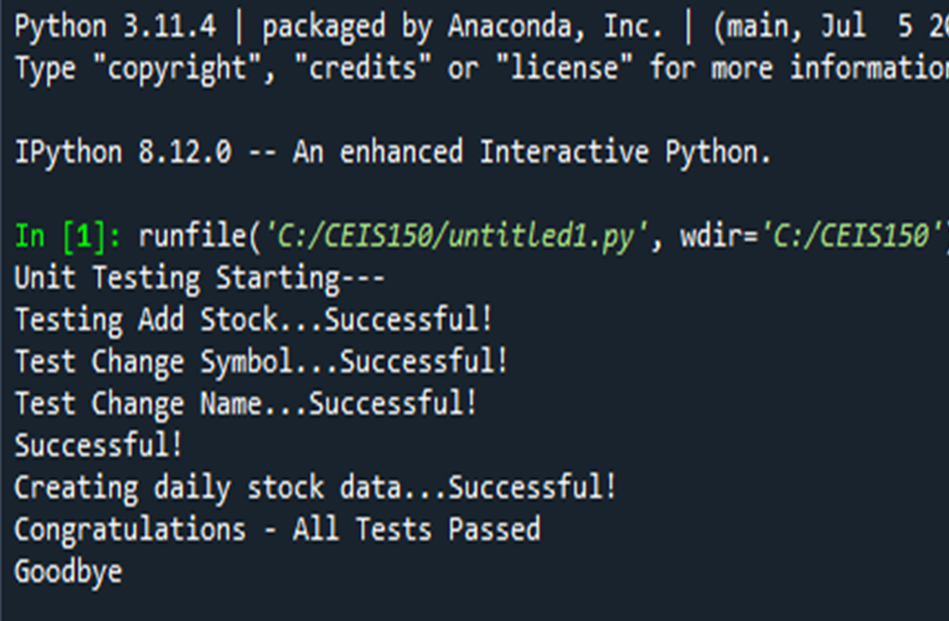
SETUP TIME
Objectives
Make a gameplan on what we will be focusing on
Testing our units making sure we are good to go with our code to start
Creating a “stock_class.py” file
What I Learned:
In this first part of the course, I had a good idea with the starting part where we create a diagram to help get groundwork done before diving into the project itself.
Now using “self” statements was newer for me since we only have brushed on these statements a few times, so was nice to be able to fully learn how to use them.
We ended up creating 2 classes to help us set up for the start, a “Stock” and a “DailyData” class.

Slide 4
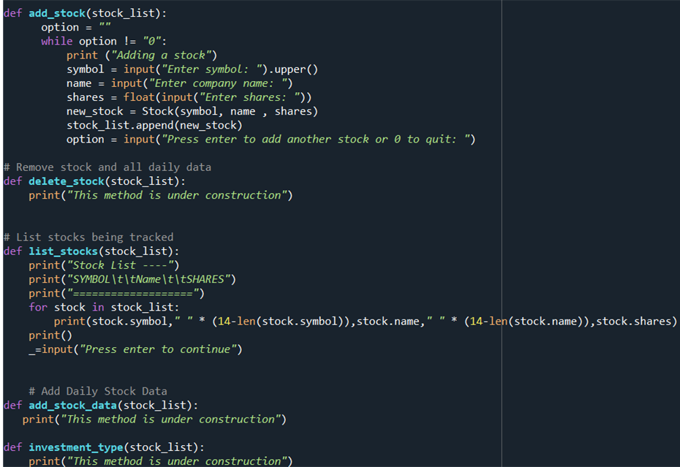
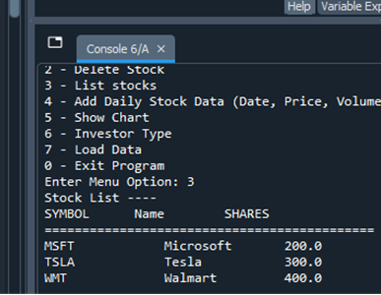
Dealing w/ Stocks
Objectives:
Creating a code that we can add stocks and list them (for now)
Adding 3 stocks to our list
Seeing the process for DailyData
What I learned:
In this project, we learned a bit more into the coding itself and added more to the code and ended up creating a menu for it.
We put the ability to add a stock and having inputs for commands based on numbers one would press.
We also made it so we could view the process of when we add the stocks which we used Tesla, Microsoft and Wal-Mart.

Slide 5
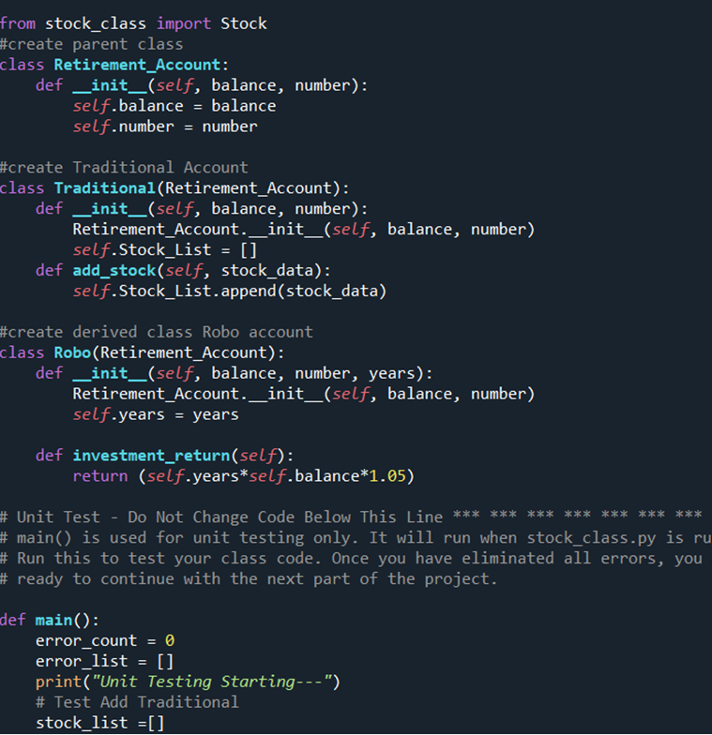
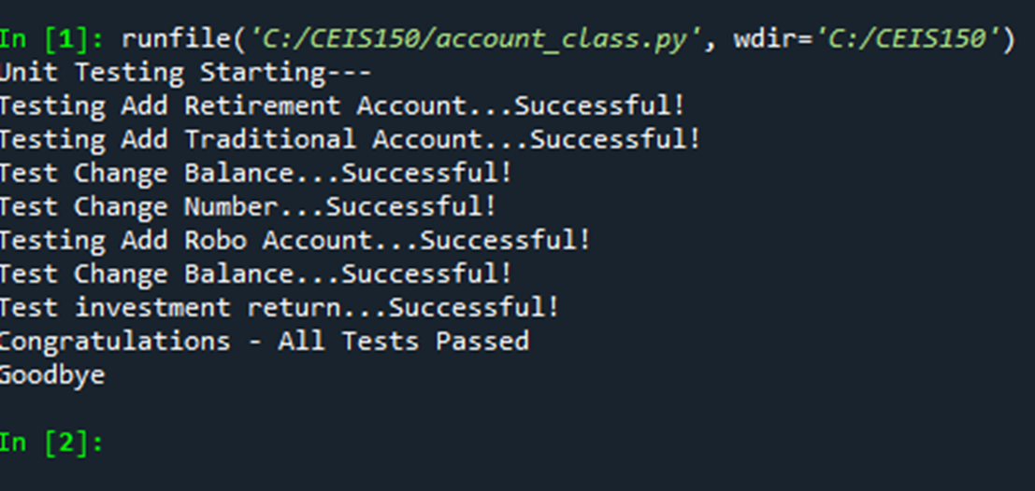
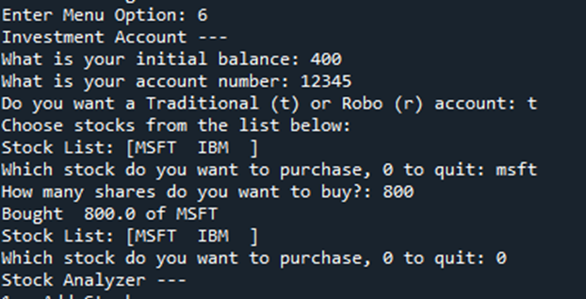
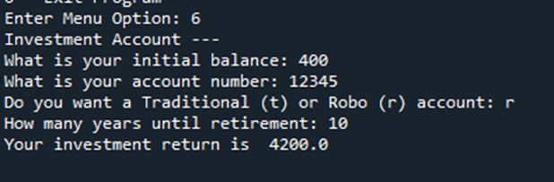
Dealing with types of accounts (Traditional/Retirement)
Objectives:
Creating an option to add to Retirement and Traditional accounts
Creating inputs to accurately put correct data when program asks us.
What I learned:
This week we learned about how to add retirement and traditional accounts and was very interesting. Once the code was created, we needed to test the code to make sure it worked correctly before we could use it.
Once that was done, we ended being able to use our own inputs to make the code work as seen in bottom photo.

Slide 6
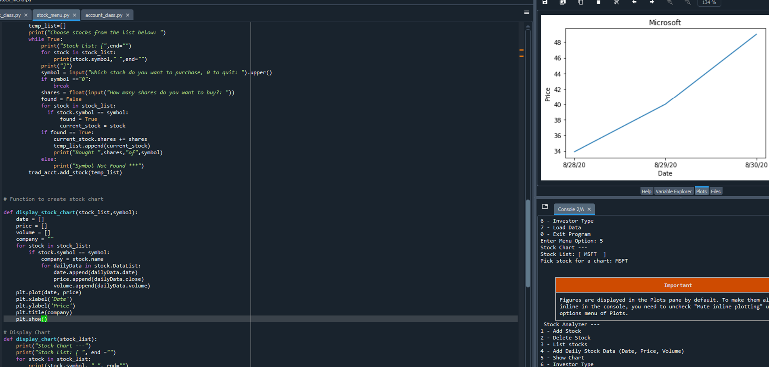
Charting our data
Objectives:
Add ability to add a chart for data
What I Learned:
We learned how to display our data into a chart
We ended up adding to the stock menu page and adding the ability to display a chart for whichever data we put into.

Slide 7
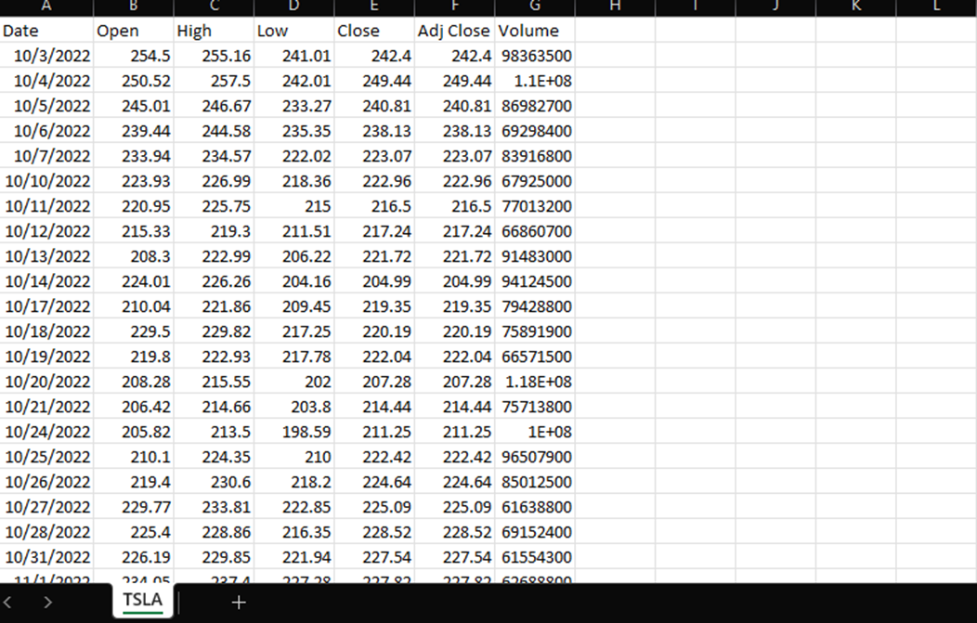
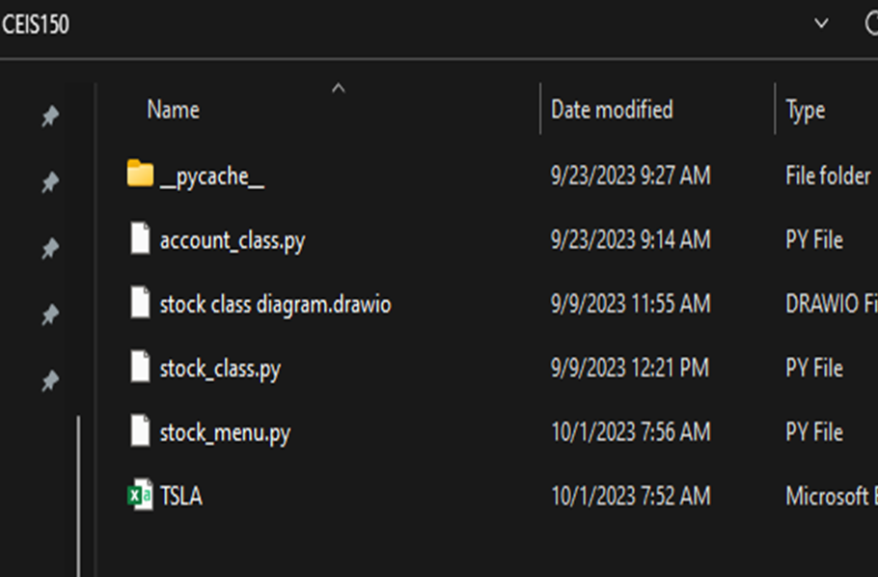
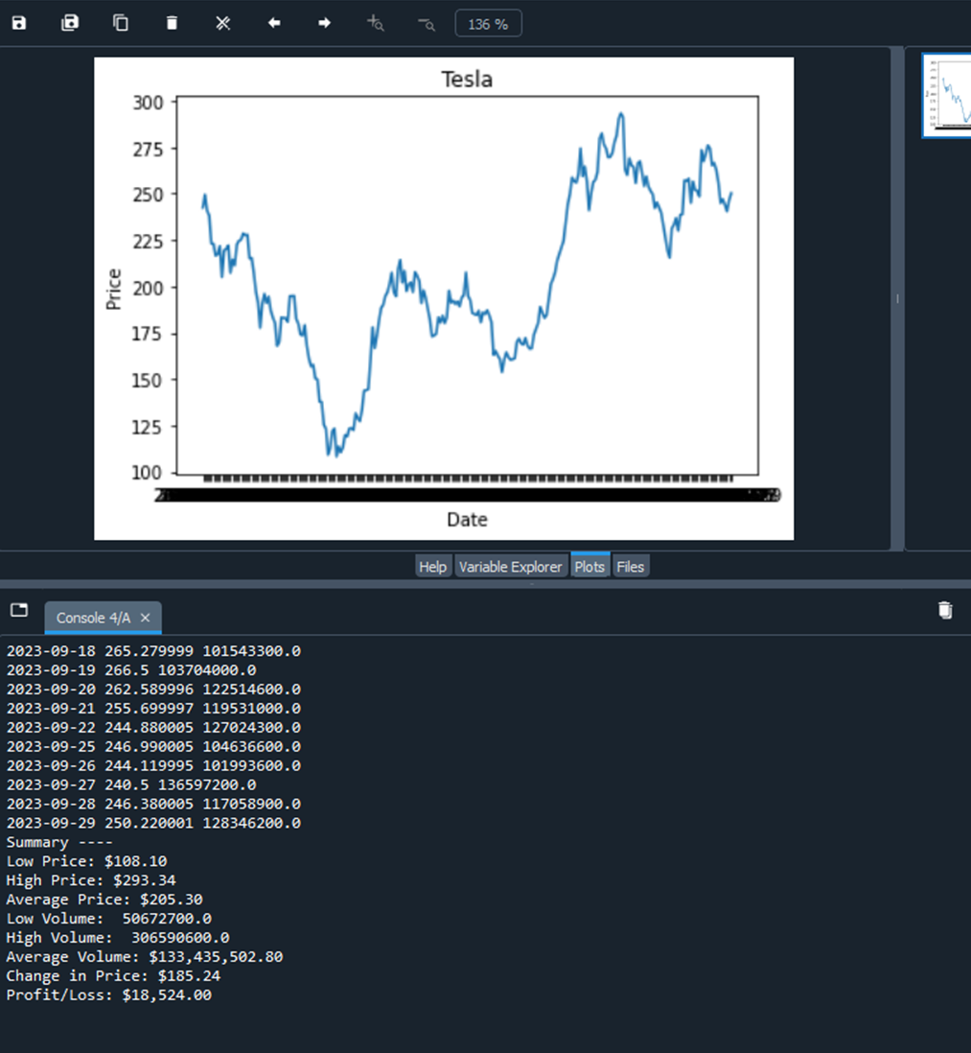
Loading Data
Objectives:
Import current stock market data from web
Create a spreadsheet when we export the data we pull from web
Graphing the data
What I Learned:
I thought this week was cool on how we were able to learn how to export data we pulled from Yahoo page where the stock market was. We created a spreadsheet with said information and was able to create a file that was usable by the code to take that data and use it.
We were able to create a summary of the stocks such as Tesla like I used and saw the low/high/average price, low/high/average volume and the profit/loss and change in price.
We then were able to plot a graph and see how it changed over the months. I would have liked to try a different company like Unreal Engine developers which has been in the news due to them selling stocks (insider trading potentially)/

Slide 8
Dealing w/ GUI’s
Objectives:
Using the program we created and using a GUI to see how our code works
What I Learned:
Now this was something, we got to learn how to use a GUI and being able to see how code into action and using the data we imported and implemented in the code itself was very satisfying.
**Photos for this slide are on next slide

Slide 9
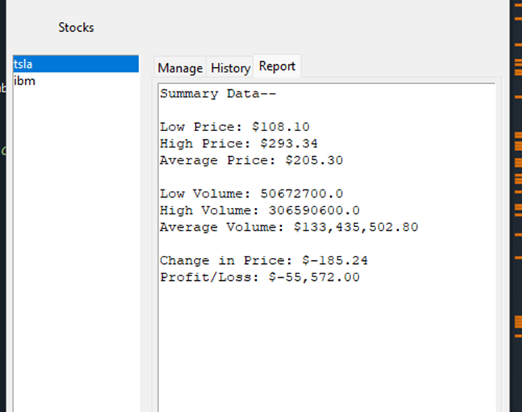
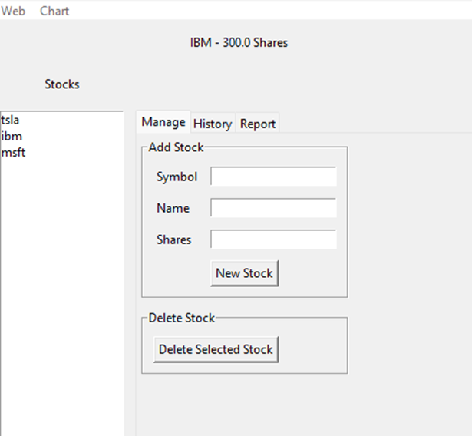
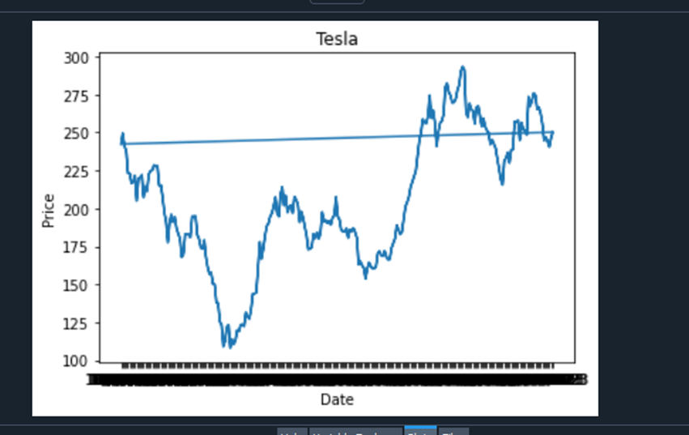
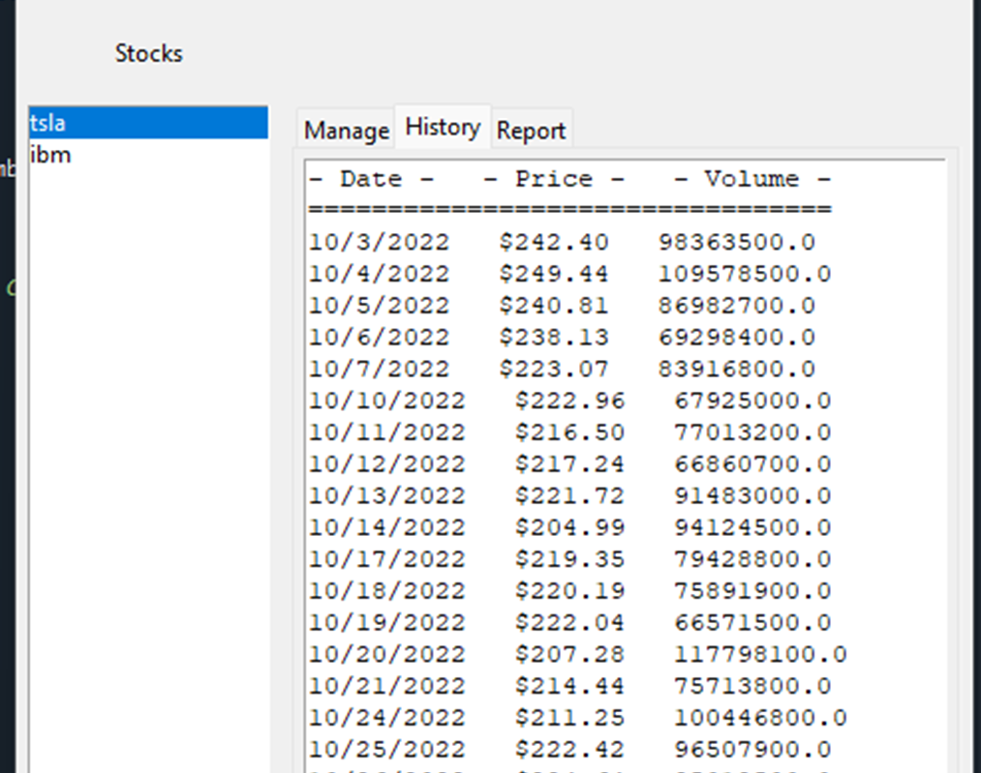
Dealing w/ GUI’s Part 2

Slide 10
Skills I learned
Over this course, I learned a lot. Learning to be able to use classes, being able to import data and use that in the code as well was very cool. We got to learn how to efficiently use the code and with me per say there were times were I messed up and this course helped me learn to watch for those mistakes and helped me identify them and fix them.

Slide 11
Conclusion
In conclusion, I am more adept in using Python and being able to know more on how to use previous progamming skills

