Slide 1

Week 8 Project CEIS106
Kaleb BAKKEN

Slide 2
INTRODUCTION
Throughout the course CEIS106, I have undergone understanding how to operate Linux software along with my classmates. Through 6 weeks, we have done 6 projects to help us practice in how to operate and maintain Linux and its commands and related content.
This presentation will show what I myself have learned throughout this course,

Slide 3
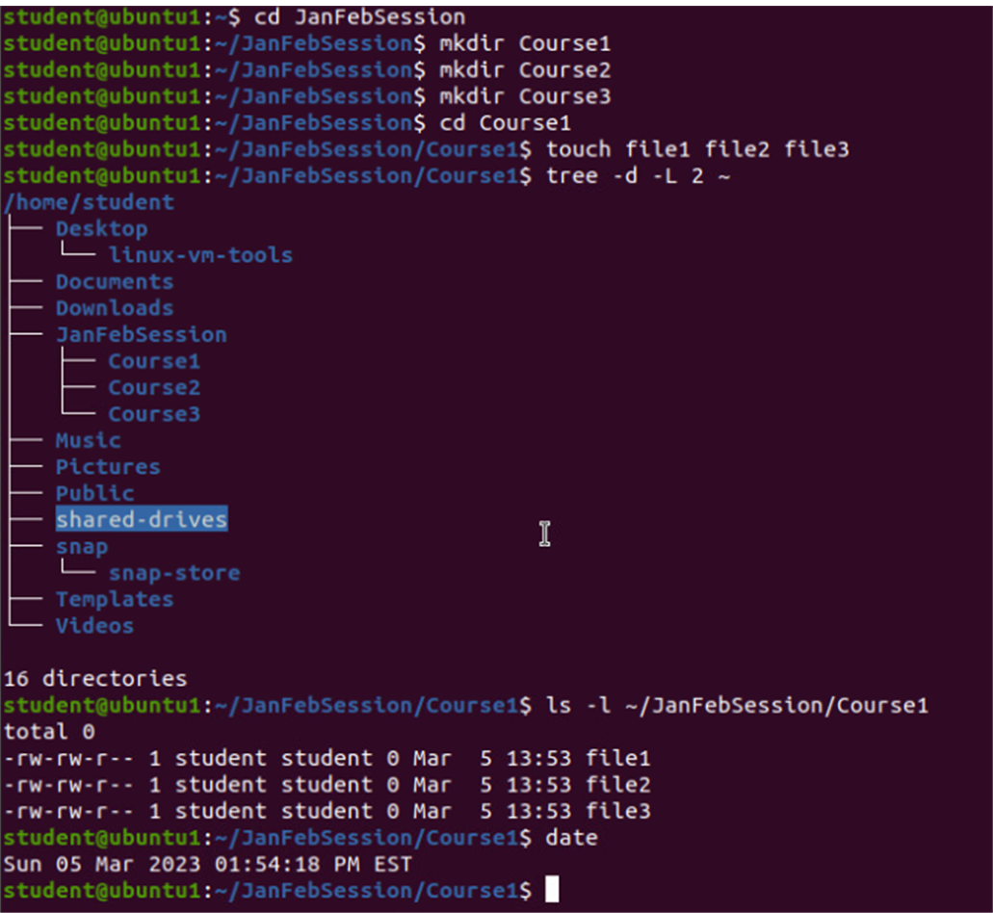
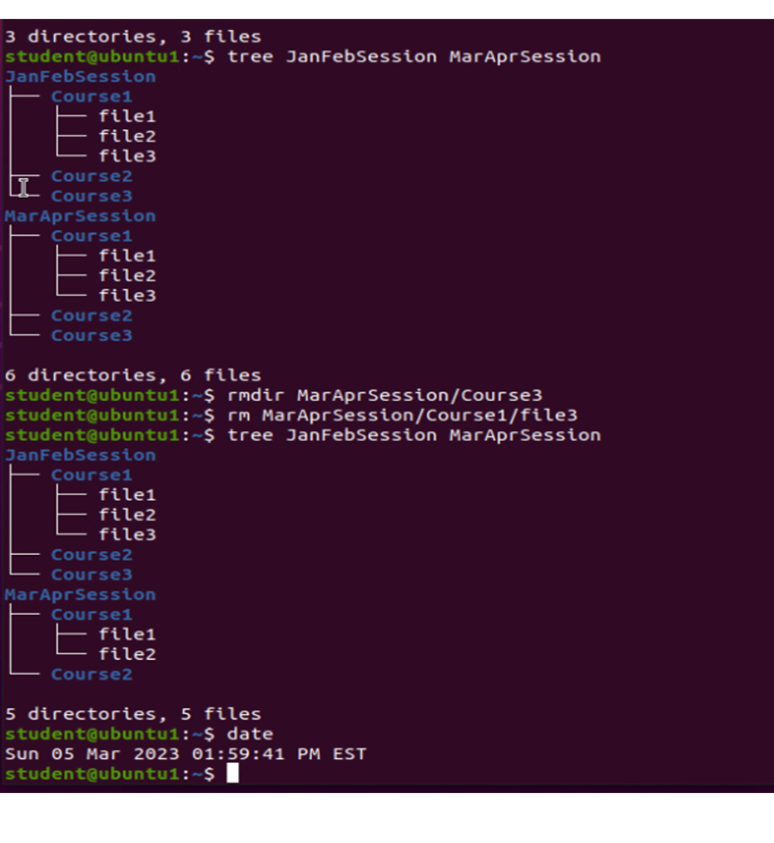
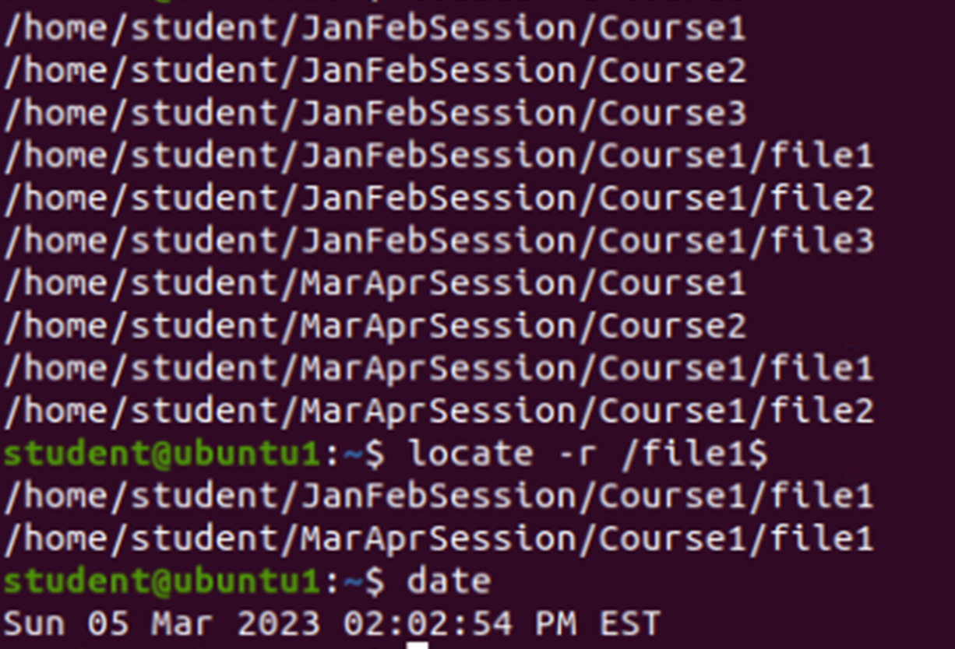
Creating/copying/removing/locating directories and Files (Week 2)
We learned how to be able to access directories and read them
Being able to access and create a new directory while copying files and removing certain files to make a new directory altogether
Being able to view the changes we made to the directory afterwards was very rewarding

Slide 4
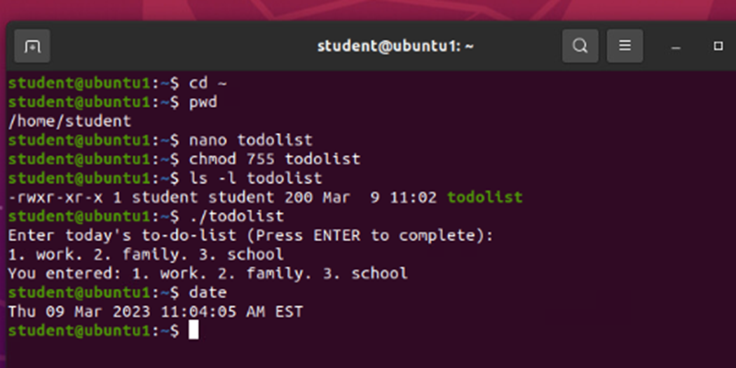
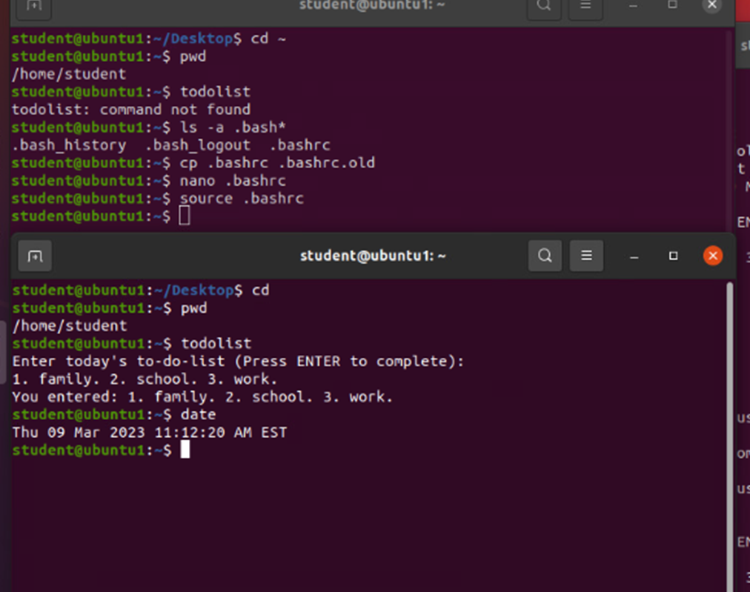
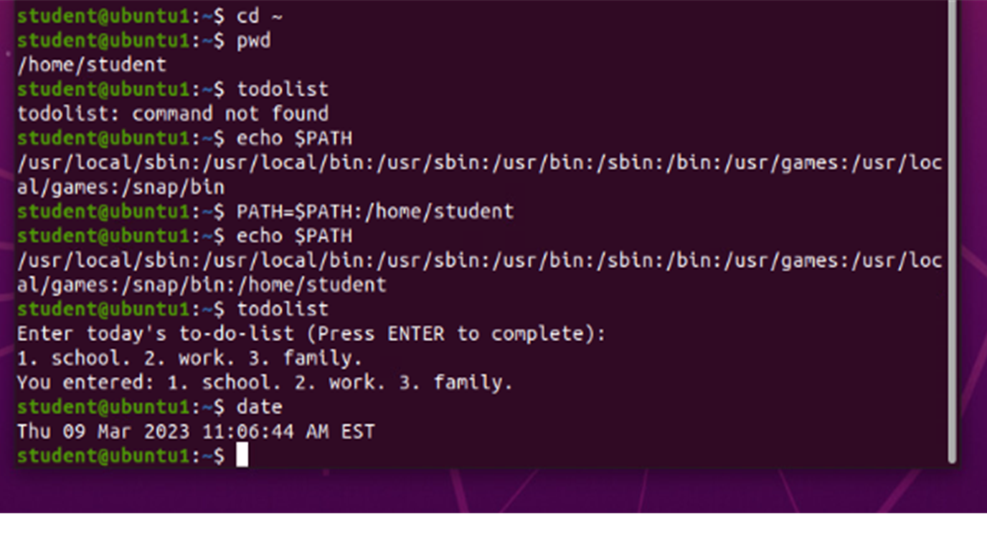
Changing Script Files and Setting and making permanent path variables (week 3)
Here we used a “todolist” to create a script file
We edited this “todolist” so when we input command “todolist” it should pop up as this: 1. work. 2. family. 3. school
In able for the command to work though we had to make sure the PATH was going to be permanent so it can function.
So, we went into PATH directory and made sure PATH would recognize this command. Which “todolist” could be any command we were just given this as an example.

Slide 5
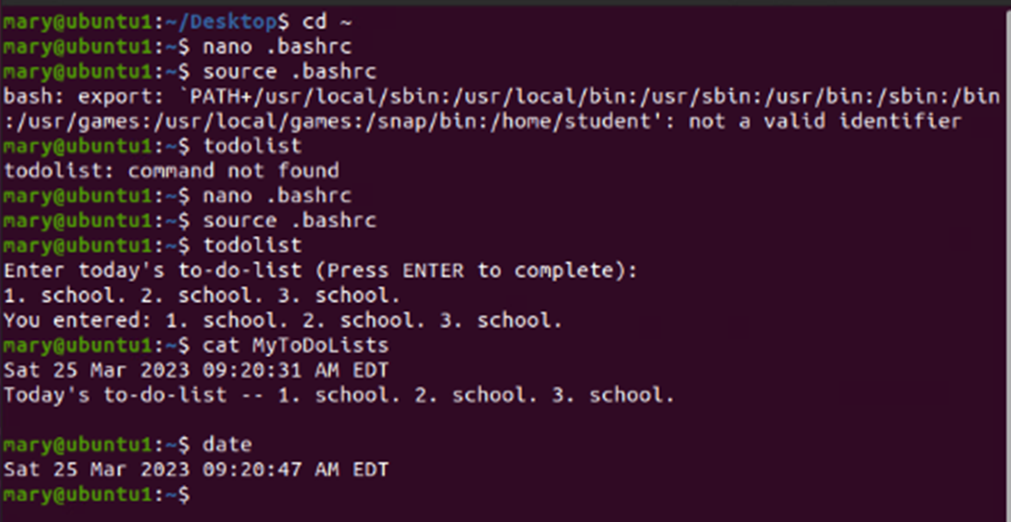
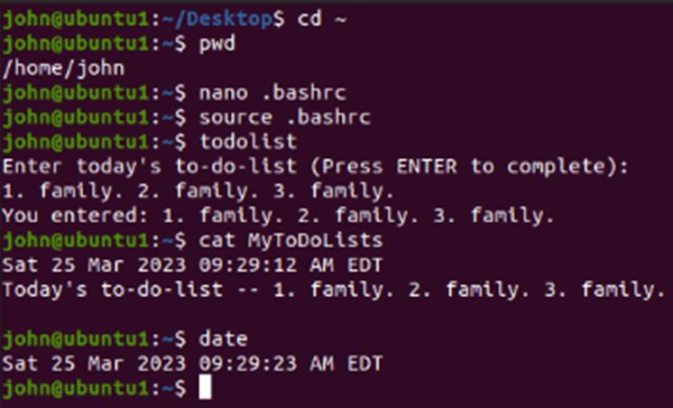
Testing user/group setting and adding/removing users and Groups (week 4)
This week, we were exploring the settings of users and groups, as well as being able to add and remove said users and groups.
As can see in examples with user “mary” I had to redo my option of adding user “mary” but once I did, I was able to view “todolist” since there wasn’t permission for different user to access said command.
Process of adding a user was straightforward as well, just being able to access settings and create a new user and making sure it was able to log in which we created the password and made it so Linux recognized this user and would give it permission to access command “todolist”

Slide 6
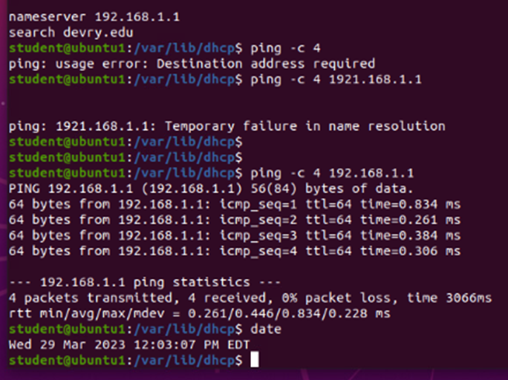
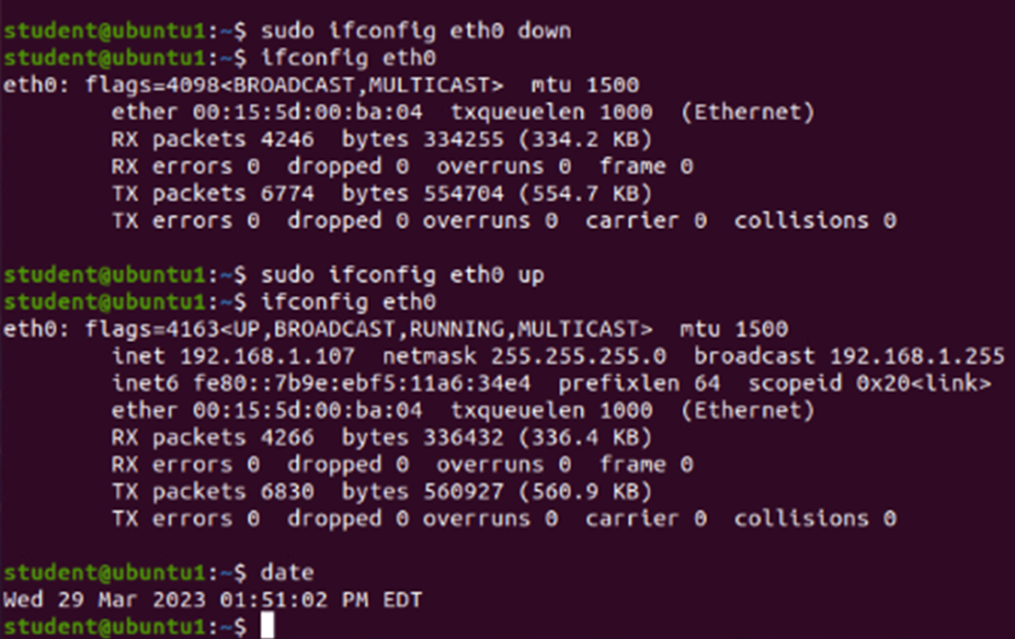
Maintaining and managing Network utilities (week 5)
As one before I made a little mishap again and had to go back and alter my command.
This week though, we learned how to see usage of our IP address that we had obtained from using virtual devices
We learned how to configure usage, by making sure we used command “sudo” which is a command meaning “superuser do”
That command gives us option to edit certain requests
Being able to shut down certain utilities makes it easier to maintain and manage if need be

Slide 7
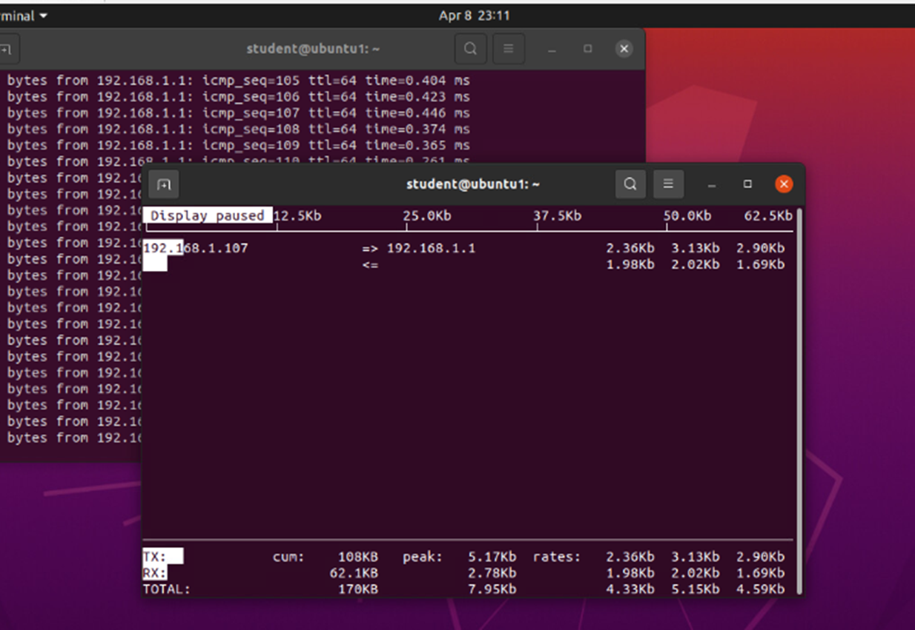
Monitoring systems/usage (Week 6)
This simply was being able to learn how to access the monitoring command and being able to read the information that was given.
To access this page, we needed to learn command “sudo iftop” and we got to learn how to operate this page and its shortcuts
In able for me to access the usage and be able to pause it, using uppercase “P” was able to pause the usage so I can view the data.

Slide 8
Challenges
I have never worked with Linux before, so this was all brand new to me. Was very exciting, but as with most new things come new challenges and new learning curves. Biggest thing for me was learning the commands. Even now I don’t have even half of them memorized. Being able to not find a 100% reasoning behind command acronyms made it harder for me to adapt, but I persevered and was able to learn how to at least become a beginner at using Linux.

Slide 9
Career Skills Obtained
Ability to run Linux as a beginner
Learned commands that are vital to maintaining Linux
Ability to troubleshoot commands if stuck
Understand an introduction to networking and to Linux

Slide 10
coNCLUSION
Overall, this course was very fun, and very learning. I learned quite a lot in this course, even if my end goal isn’t to be using Linux as a software. It’s one step closer to my end goal. I ran into challenges, but this course was able to teach me how to fix said problems and showed me how to at least get an understanding how to use Linux and use coding this way.
This was a vital class for me as well. For where I want to go in my career, this course taught me a lot and helped expand my knowledge and prepare me for my future courses.

Slide 11

Thank You
someone@example.com

