Slide 1

PHYS204 Final Project
Kaleb Bakken

Slide 2
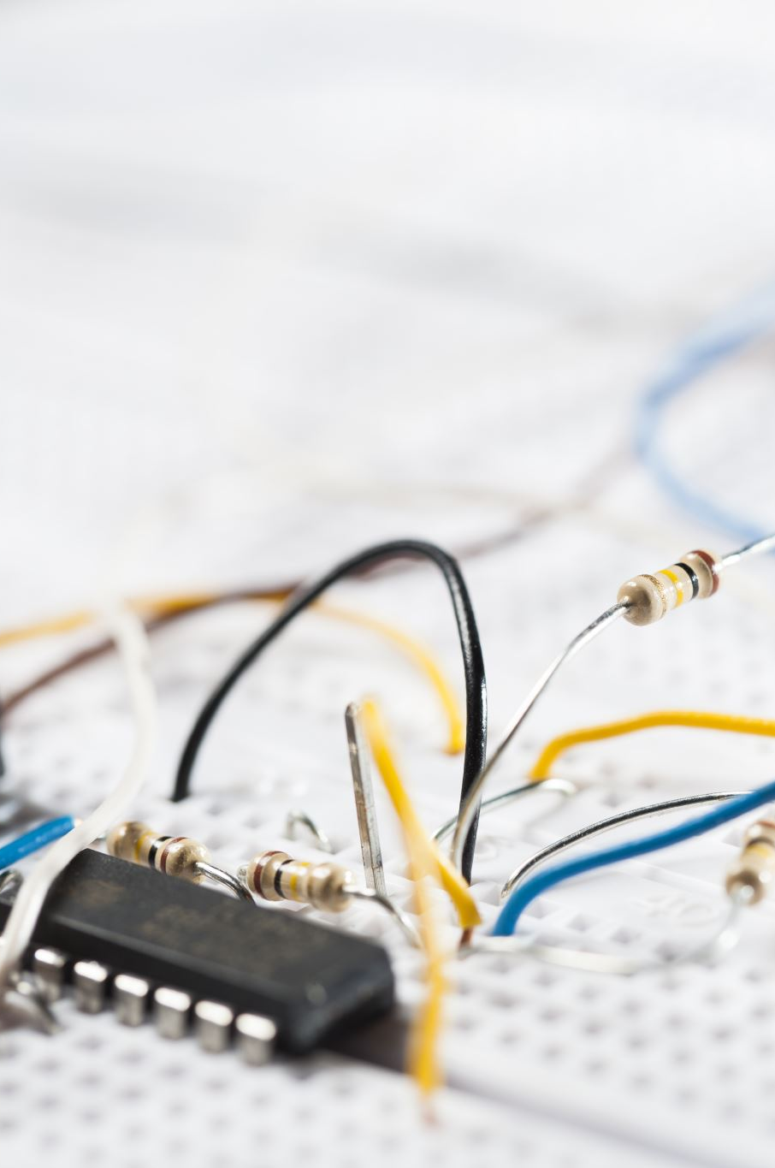
Introduction
During Project 1, we went over our inventory parts and software and made sure we understood how they all worked. Project 2 we used an ultrasonic sensor and used sound to provide us a data for velocity and used a formula to find out other answers. Project 3 we calculated the gravitational acceleration of a free-falling object by the data given to us from the ultrasonic sensor and the Arduino microcontroller. Project 4 we studying the conservation of energy in a free-falling object, and we used the data given to us by the same tools as before and used the excel spreadsheet given to us to help us graph the results. From there we used that information to find the final theoretical velocity and final measured velocity with percent difference. Project 5 we underwent understanding the relationship between linear and rotational motion by using a rotary encoder, and data was provided by using a ball rolling on a surface and was recorded. From there we used the data and calculated the results to find the encoder distance and percent difference between all five trials. Project 6 we were given a data and had to plug this data in to observe and understand the Hall Effect.

Slide 3
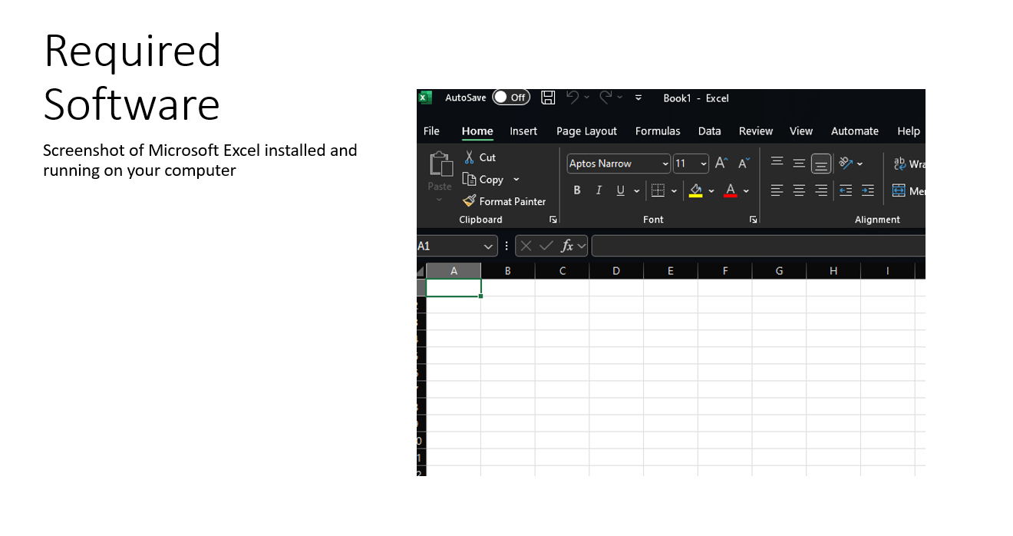
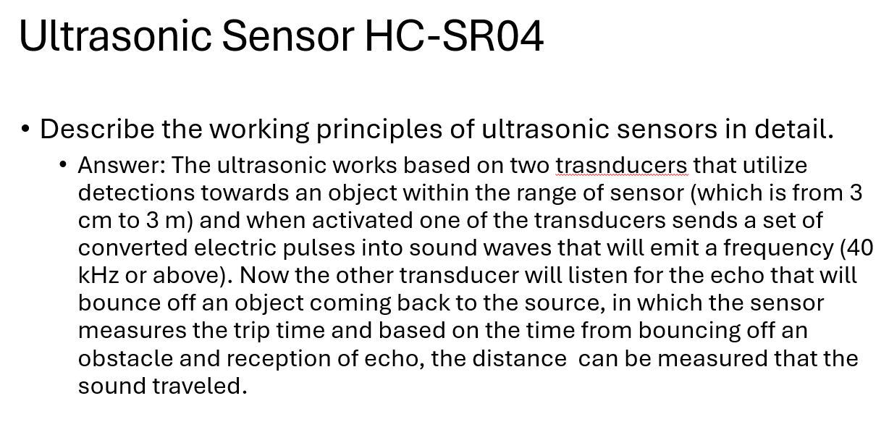
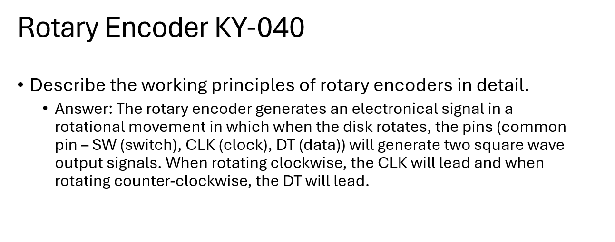
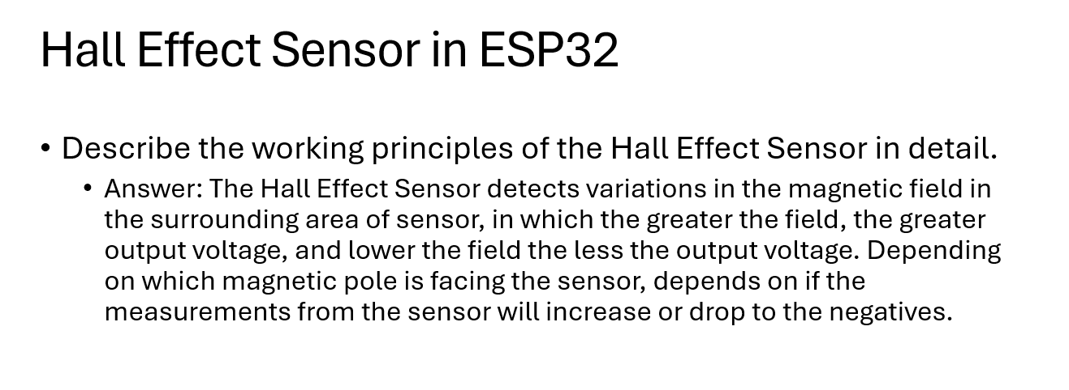
Project 1

Slide 4
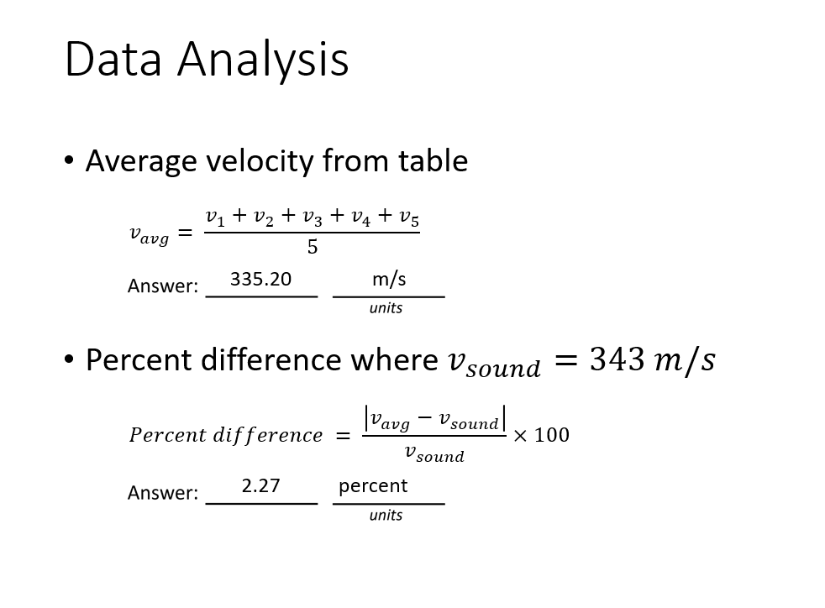
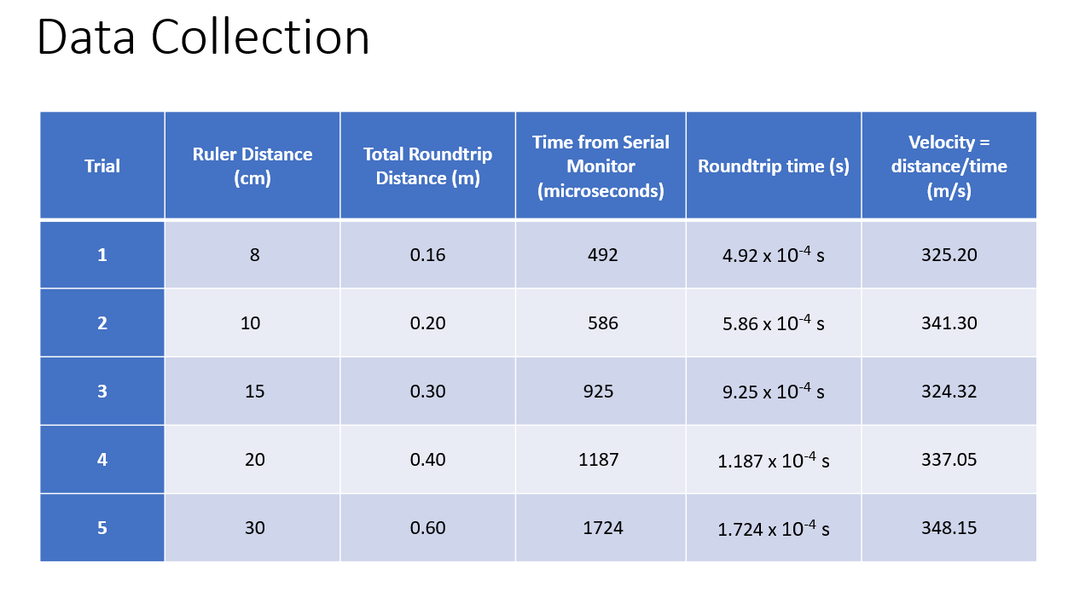
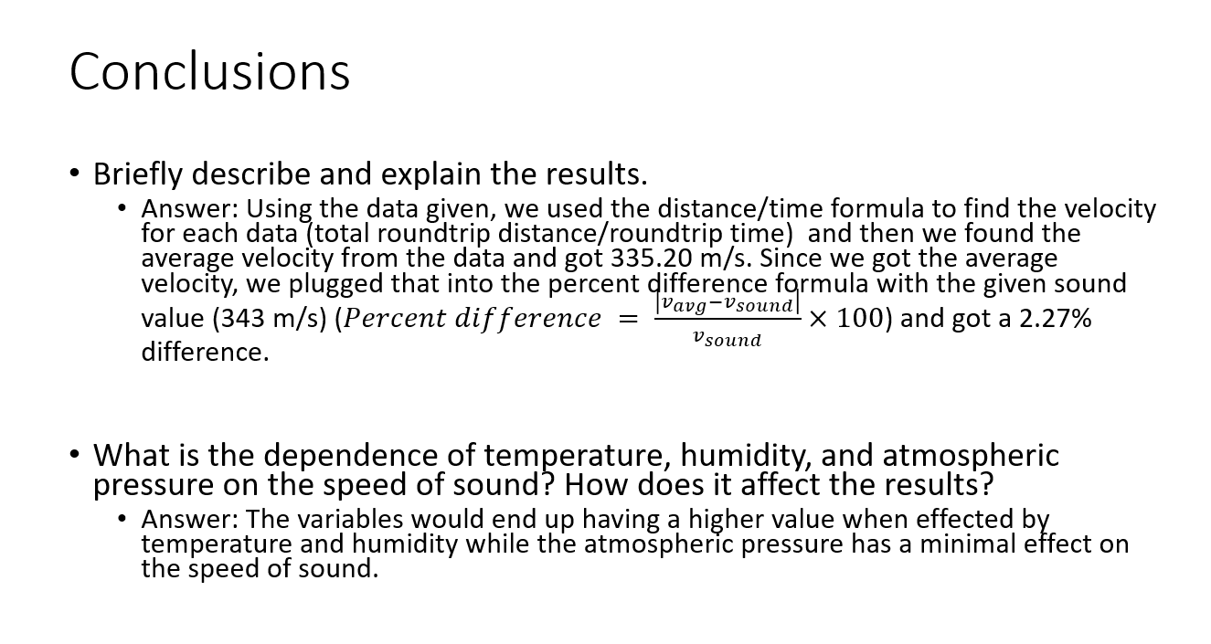
Project 2

Slide 5
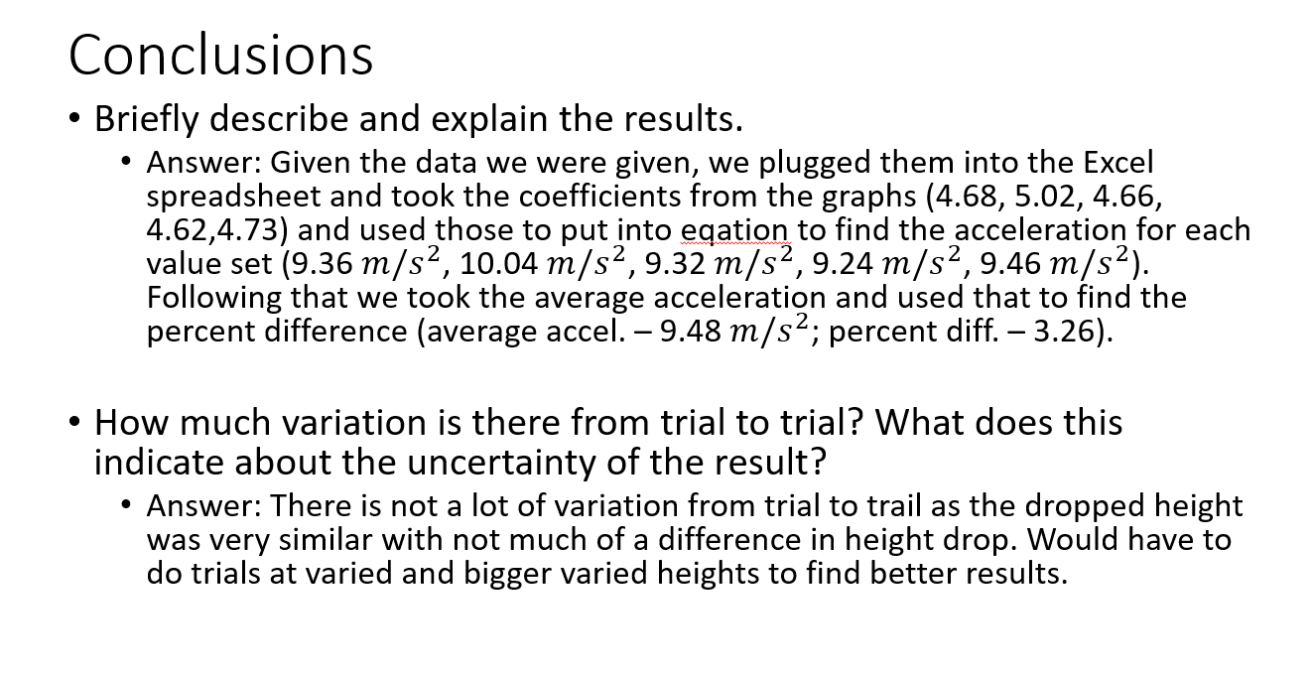
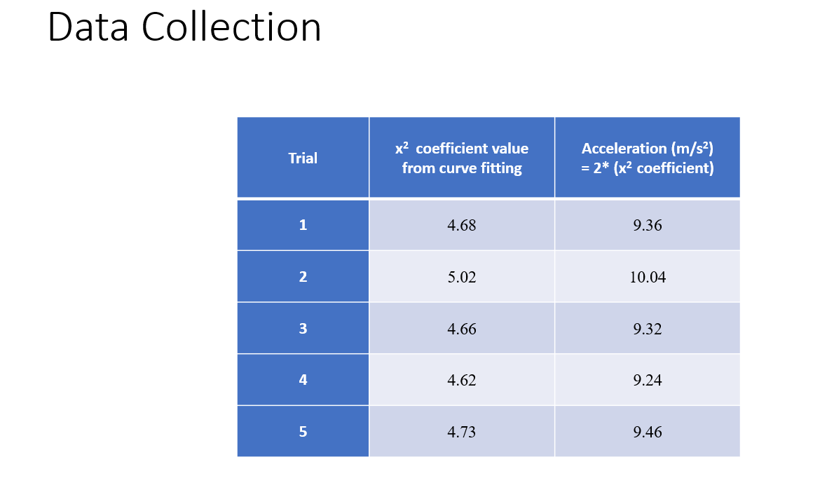
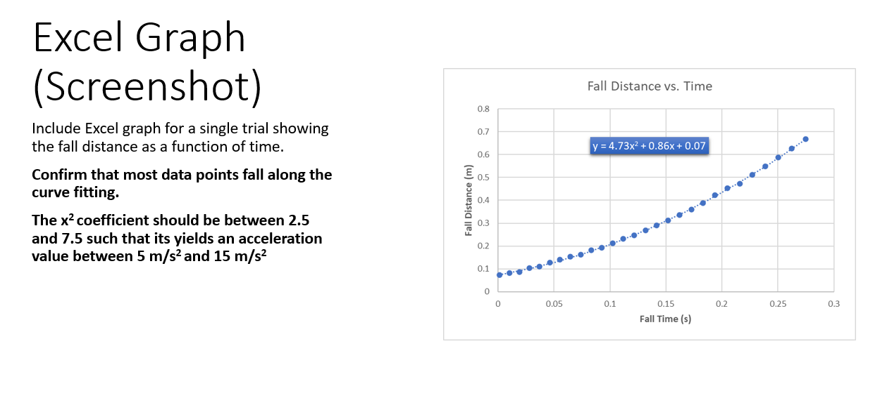
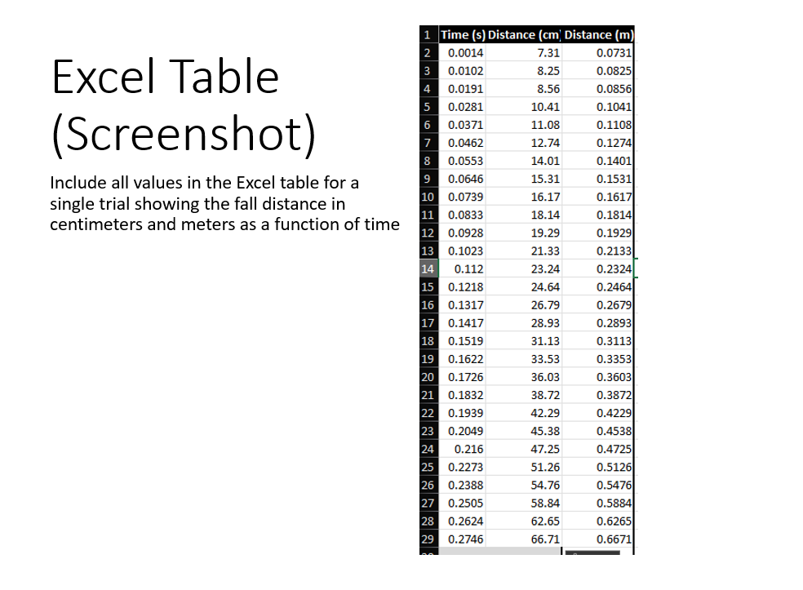
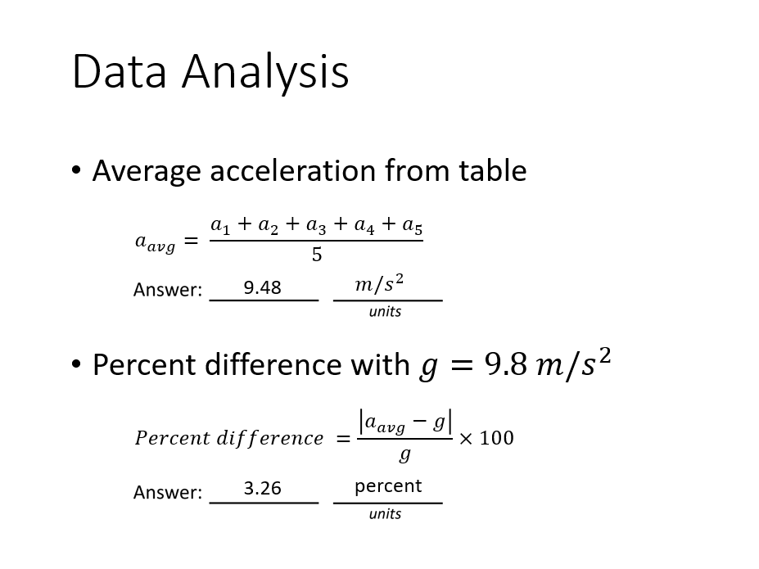
Project 3

Slide 6
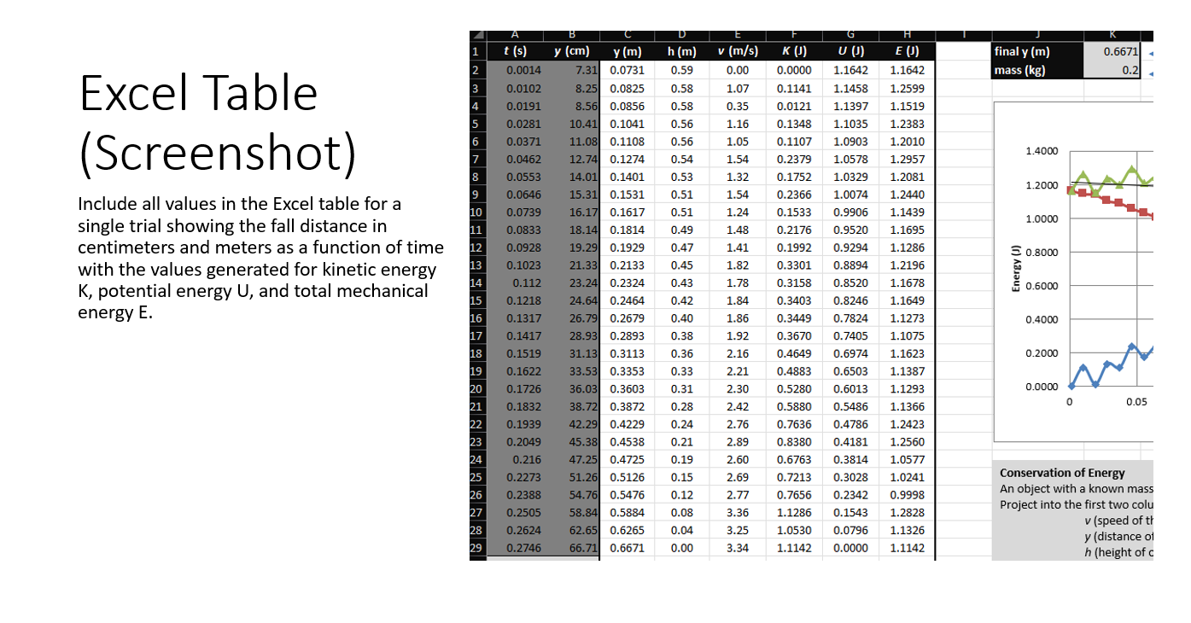
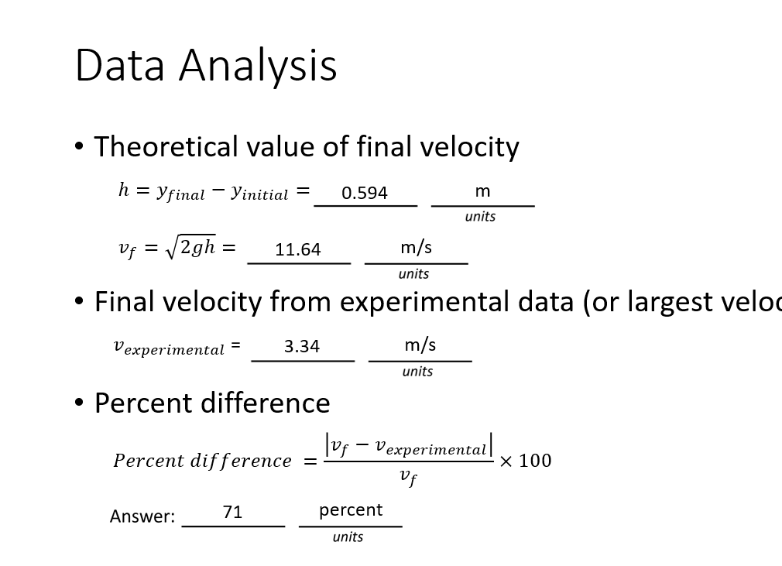
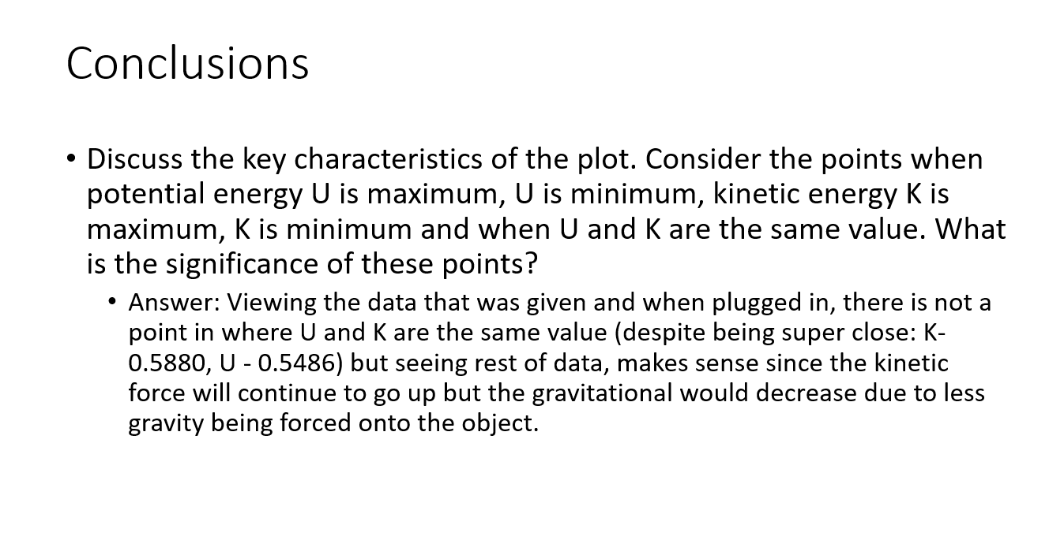
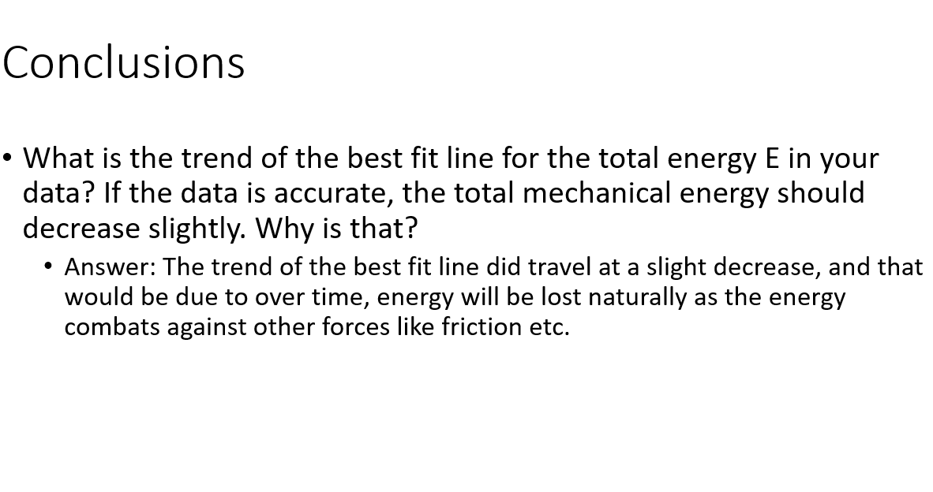
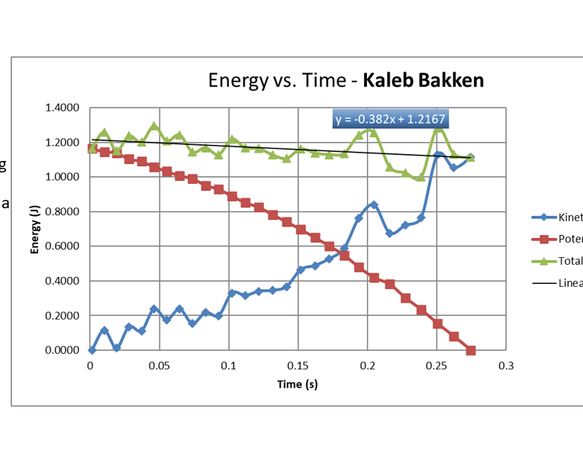
Project 4

Slide 7
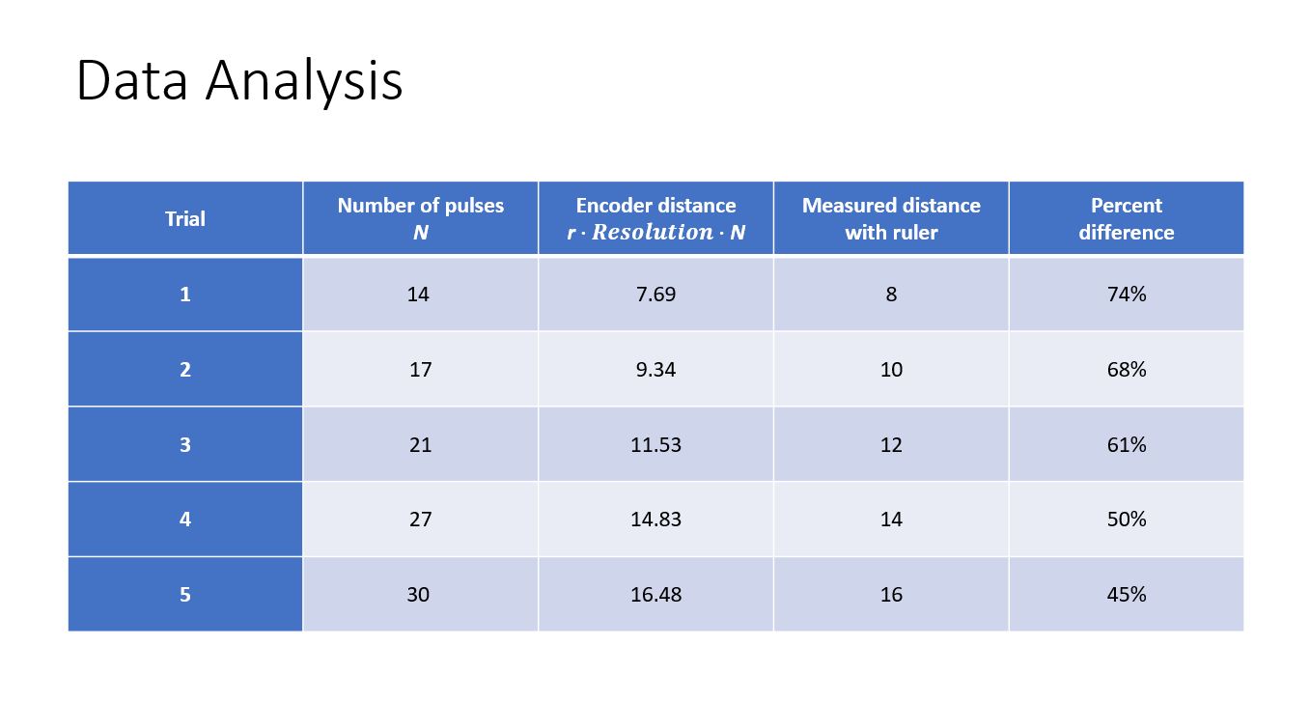
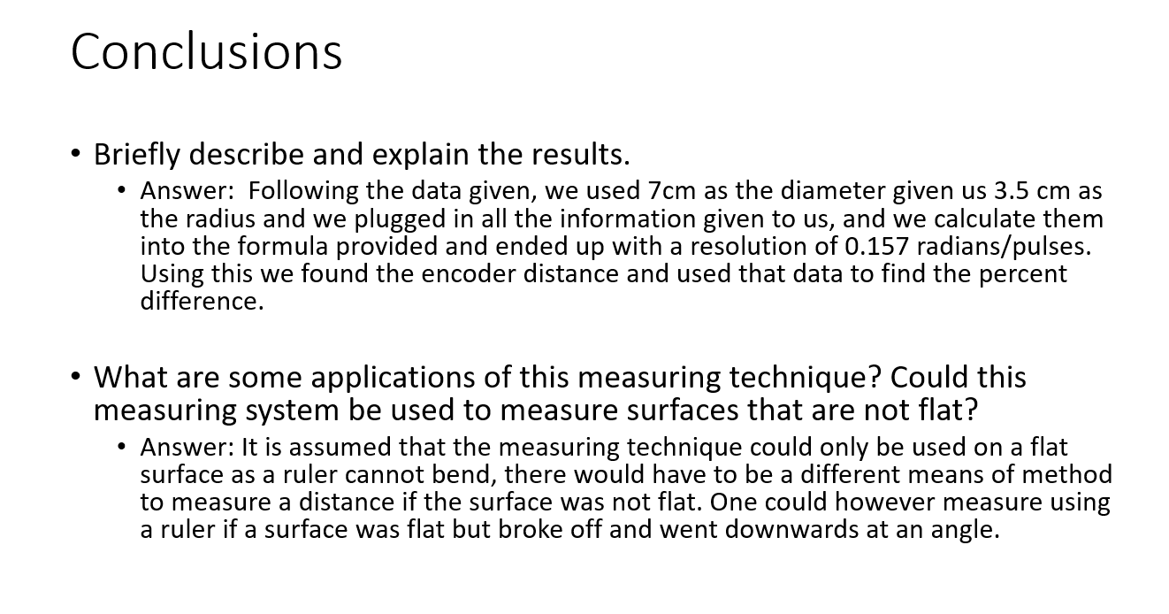
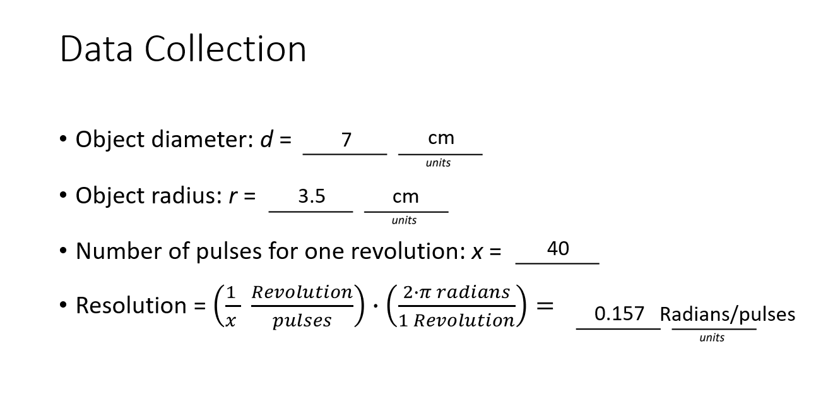
Project 5

Slide 8
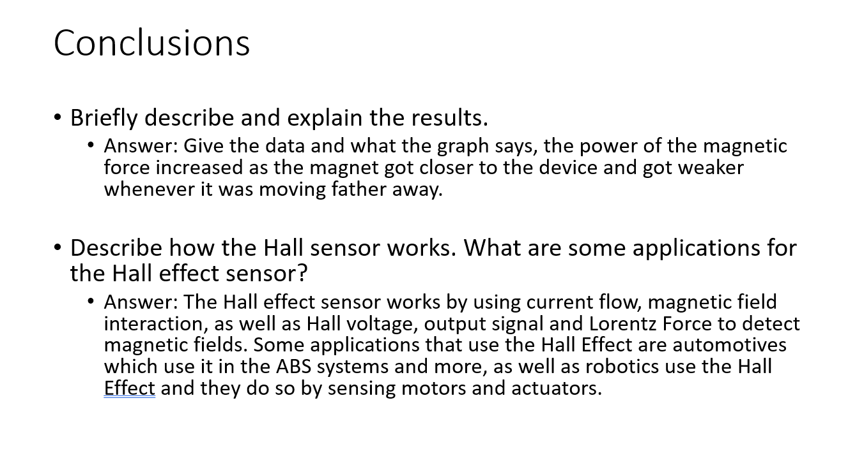
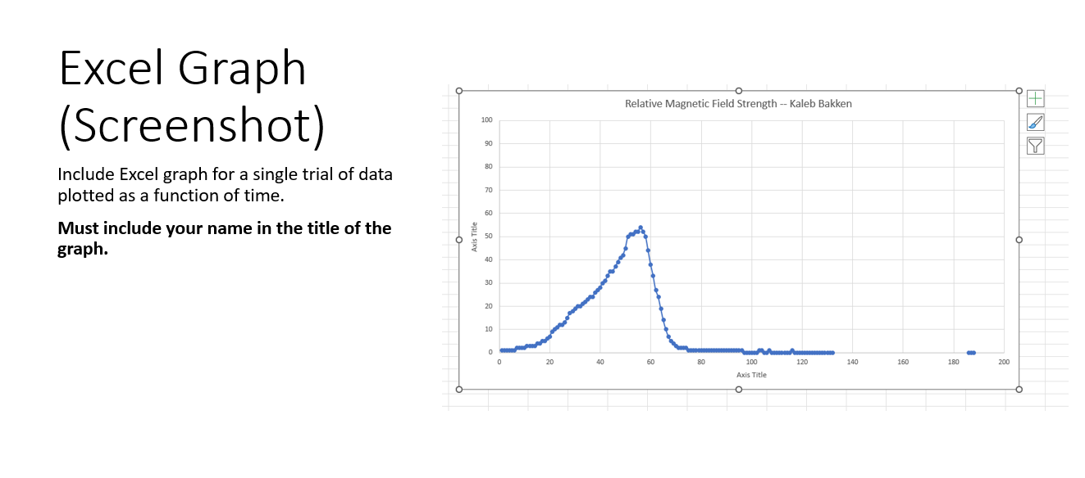
Project 6

Slide 9
Challenges
Some of the challenges I faced was more of overlooking some details, I sometimes struggle with looking at big picture especially when doing calculations as I solely focus on that. I did my best though and was helped by my professor to help understand where I went wrong.
Some parts of the project that created the most difficulty were doing the calculations as I am not super great with math, but if I have the methods to understand the formulas (which was provided) I am good to go.

Slide 10
Career Skills
What skills were developed that will benefit your career? Some career skills developed were using outside of the box thinking and extreme critical thinking as sometimes we do get wrong calculations, and it never hurts to triple check our work to make sure it all is correct and all correlates
Some competencies that will help gain gain the opportunities to advance my career is being able to make my work flawlessly will greatly improve my opportunities in my career as a software developer/full-stack developer

