Slide 1
Final Course Project CEIS110
Kaleb Bakken

Slide 2
Introduction
We will be going through projects covered in the course CEIS110 that helped me able to understand and become knowledgeable about Introduction to Programming.
Throughout all course projects I used the software Spyder and that is where the coding I did was used.

Slide 3


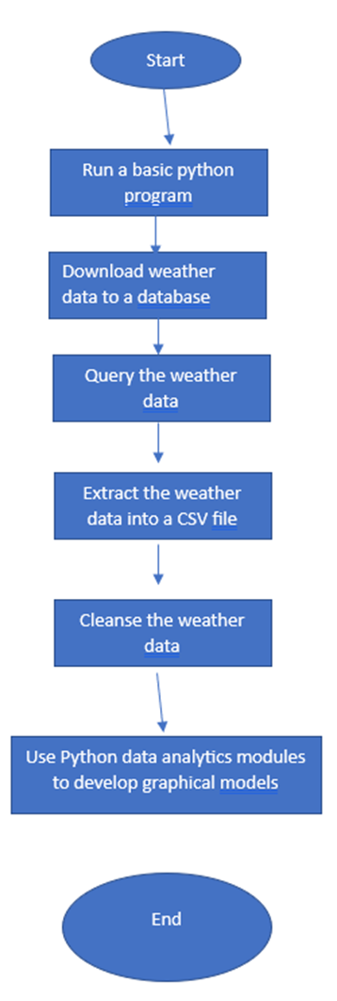
Course Project 1 P.1
This first-course project we went through and made sure to fully understand the concept of using the Python programming language
Also covered how beneficial flowcharts are for being able to come up with a process.
Using Microsoft word, I created a flowchart that was being used to specify a process in regard to obtaining, and extracting weather data and being able to use coding to graph models based on the data.

Slide 4
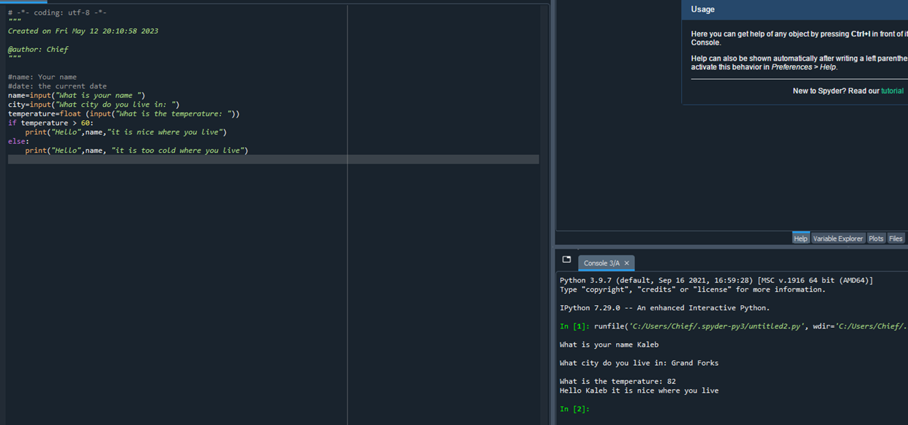
Course Project 1 P.2
Continuing from the flowchart we wanted to create a code that could tell me what the temperature is based on where we live.
The code we used is on the right.

Slide 5
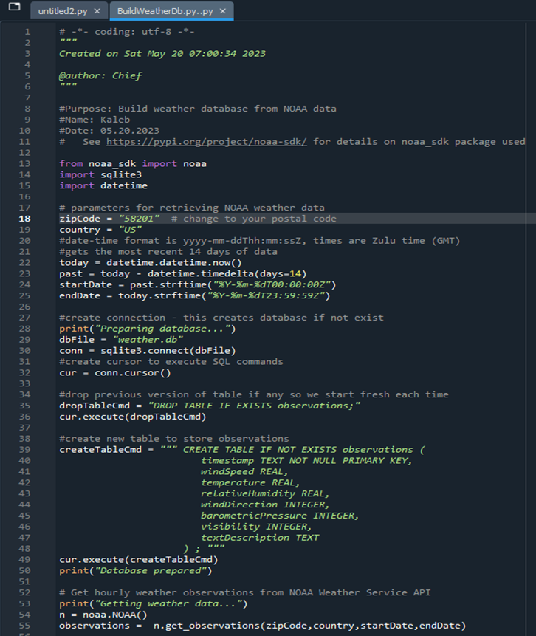
Course Project 2 P.1
In This project we ended up covering how to download specific weather data and be able to make it a file we can access.
The next slide will show 2 more screenshots of what I did for the code and how it is listed in files.

Slide 6
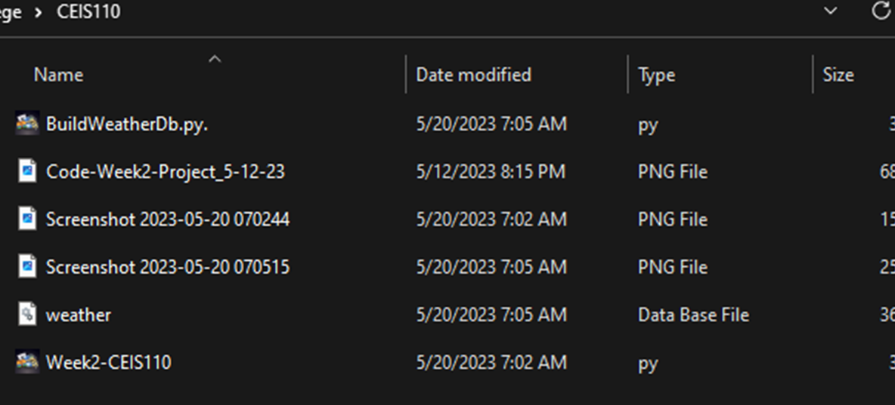
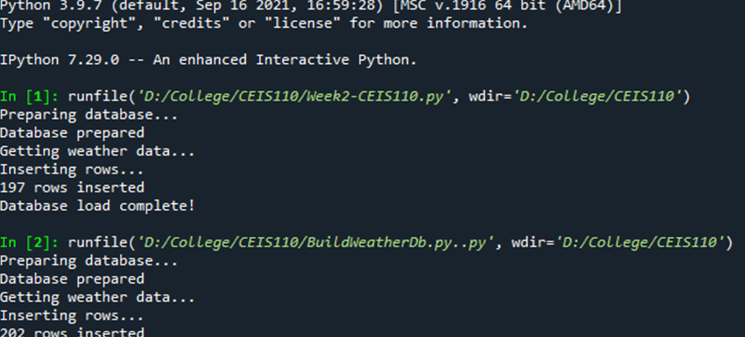
Course Project 2 P.2
Top photo shows how the file we downloaded looks like in My Files
Bottom photo shows the process in how the weather data was being downloaded.

Slide 7
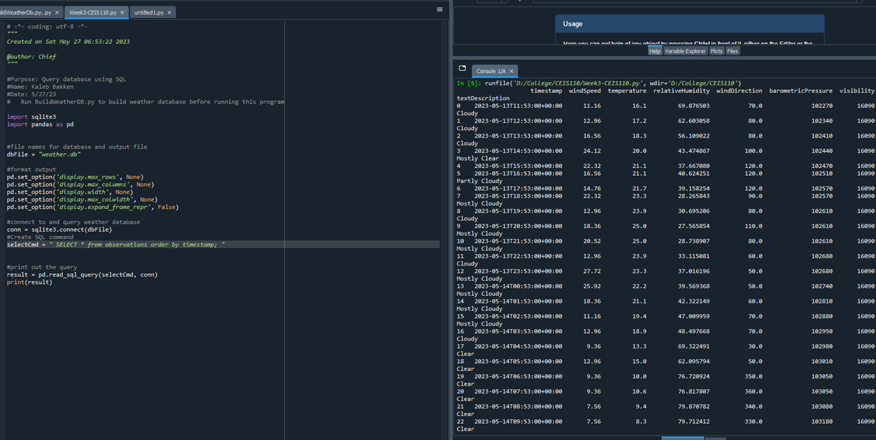
Course Project 3 P.1
After obtaining the weather data that we needed, the next plan was to be able to sort out the data and retrieve all columns and rows that give us the information we need.
The screenshot to the right shows our code and what we got for our information.

Slide 8
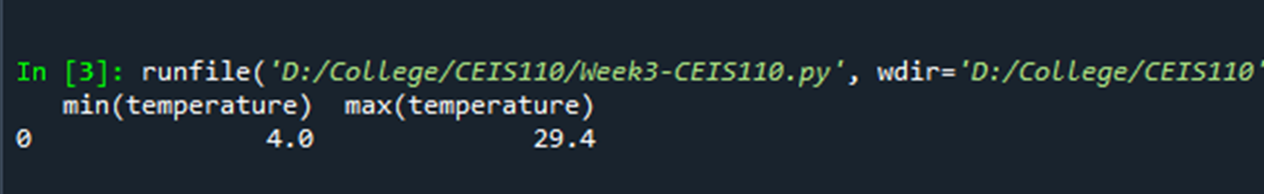
Course Project 3 P.2
Once we got all the information sorted, we ended up making sure we got the lowest and highest temperatures.

Slide 9
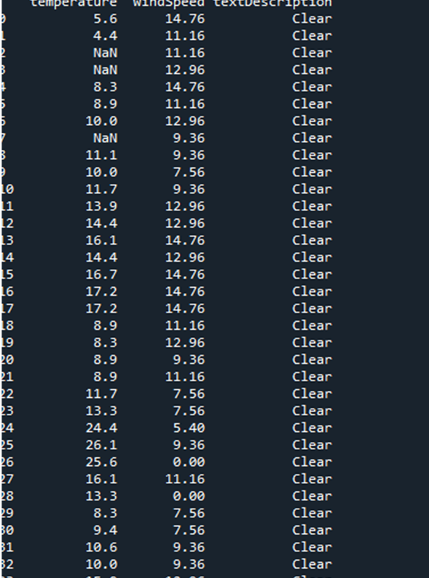
Course Project 3 P.3
Finally, once we got our highest and lowest temperature after we obtained out weather data, we wanted to isolate the data and find the days that were clear only.

Slide 10
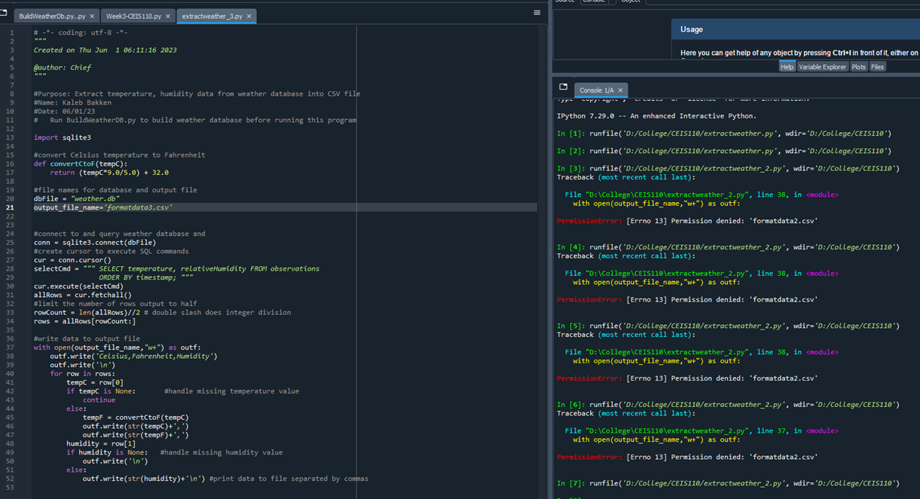
Course Project 4 P.1
Now that we have our information, and we went through trying out different methods to find the highest and lowest temperatures and finding clear days only, we went ahead and extracted the information and converted it to graph models.
To the right we have the full code we ended up using, as you can see, I had named the files we needed wrong so the code couldn’t find the files needed, so I had to troubleshoot the problem and fix it.

Slide 11
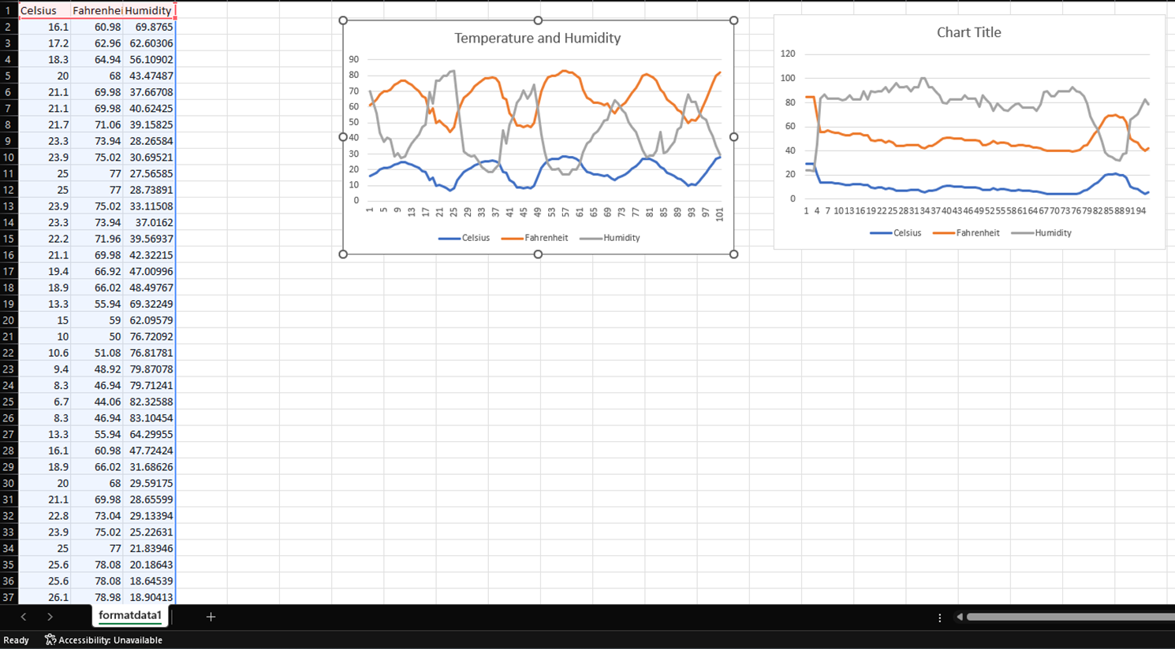
Course Project 4 P.2
Here to the left we show that we converted the data to Excel and used the information and created a graph model and used 2 different types of graphs.

Slide 12
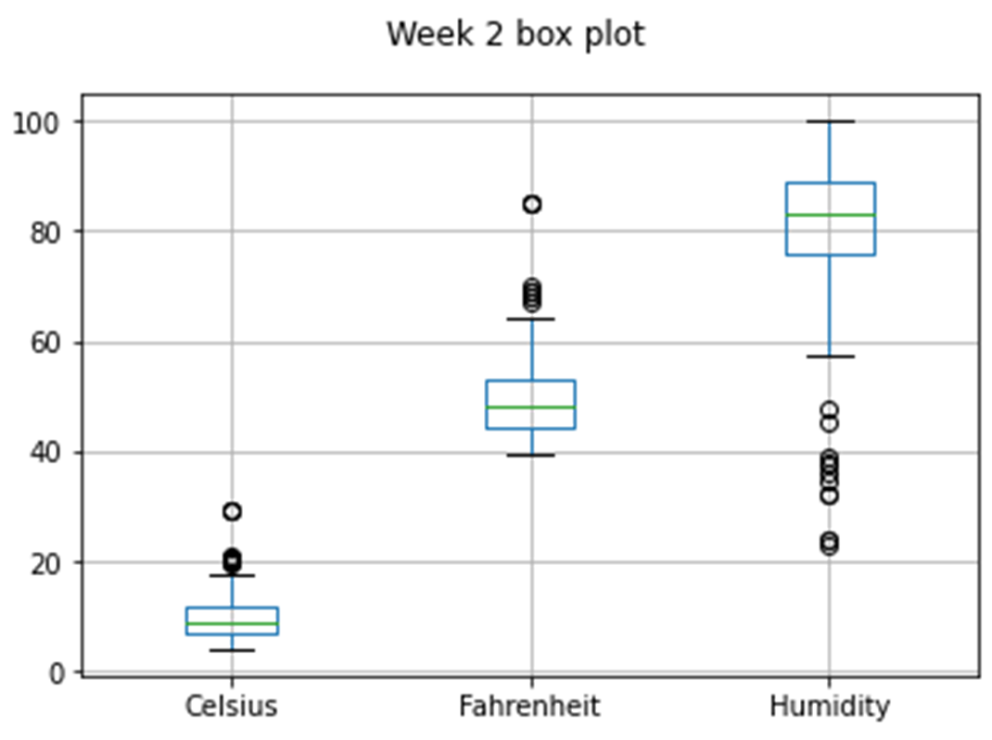
Course Project 5 P.1
With the information (data) we obtained and with what we worked with in previous projects, we ended up plotting data from specific weeks
This screenshot shows a Box Plot for week 3 showing temperatures and humidity
Below it shows the code we used
#Purpose: Create box plot for week 2 data
#Name: Kaleb Bakken
#Date: 06/10/23
import pandas as pd
import matplotlib.pyplot as plt
df2 = pd.read_csv("formatdata2.csv")
df2.boxplot(); plt.suptitle('Week 2 box plot')
plt.show()

Slide 13
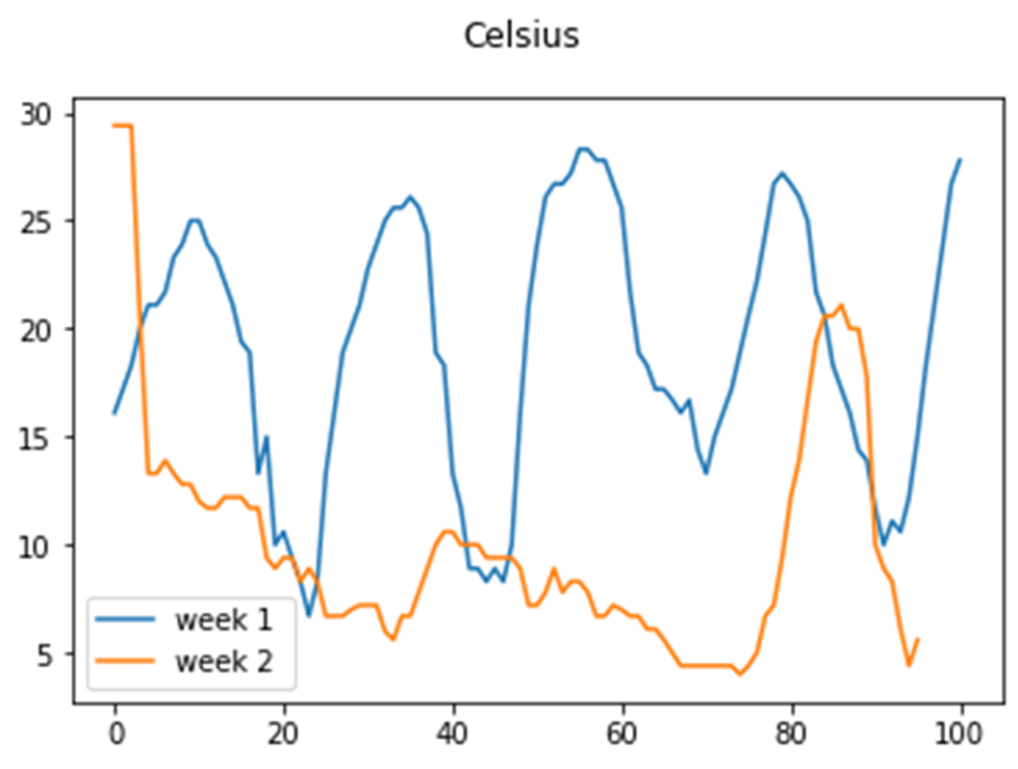
Course project 5 P.2
Continuing from the previous slide, we used a second type of graph to show data from Week 1 and Week 2.
Code used is below screenshot.
#Purpose: Create Celsius plot comparing period 1 and period 2 (week 1 and week 2)
#Name: Kaleb Bakken
#Date: 06/10/23
import pandas as pd
import matplotlib.pyplot as plt
df1 = pd.read_csv("formatdata1.csv") #baseline data is period 1 (older)
df2 = pd.read_csv("formatdata2.csv") #data for period 2 (more recent)
plt.figure(); df1.Celsius.plot(label = 'week 1 '); df2.Celsius.plot(label = 'week 2'); plt.legend(loc='best'); plt.suptitle('Celsius')
plt.show()

Slide 14
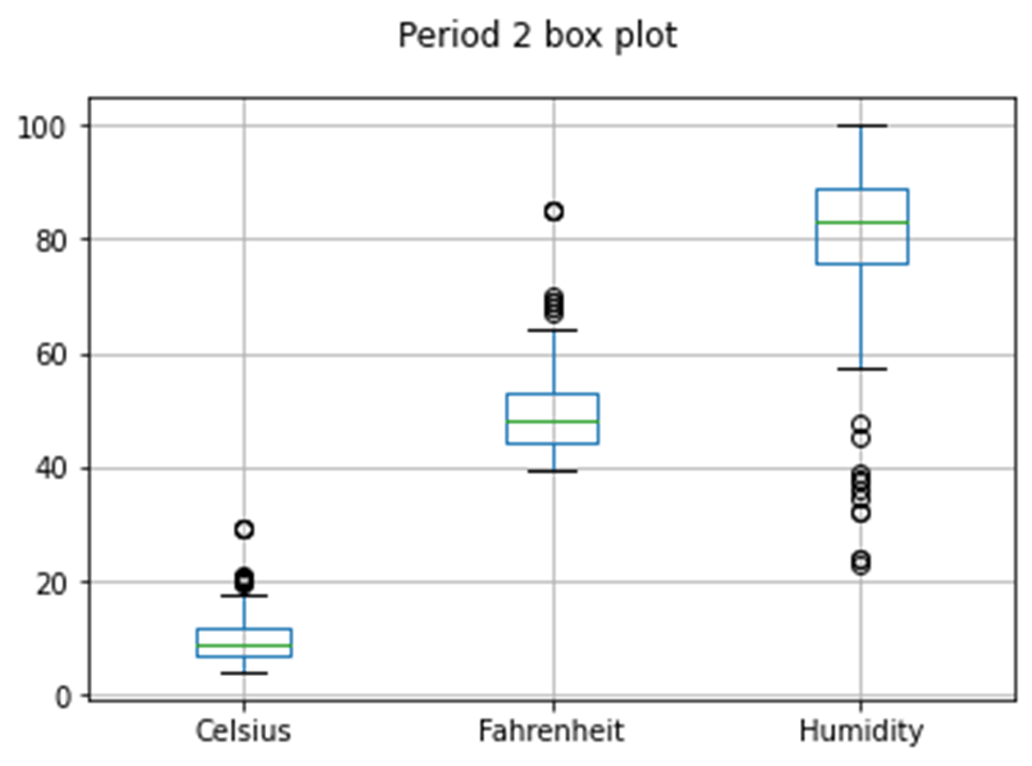
Course project 5 p.3
After obtaining information, we were to figure out our own question and code with what we have learned.
My question was, “What was the median for both week 1 and week 2 temperatures?” and based on chart and data, that was 62 degrees F and 65 degrees F

Slide 15
Challenges
Starting out this course, I was very thrilled. I had only minimal work with Python and only knew a good chunk of information about HTML so I had a blast learning about Python. The coursework was immensely informational and helped me understand it even better.
I feel very confident at the end of this course that I at least understand the concept of programing.

Slide 16
Conclusion
At the end of this course, I was able to gain a better understanding of how programming is done.
We learned how Python is used and information regarding how it is done.
We also learned how graphs can help with data and how flowcharts are essential to figuring out a process before we actually code.

Slide 17
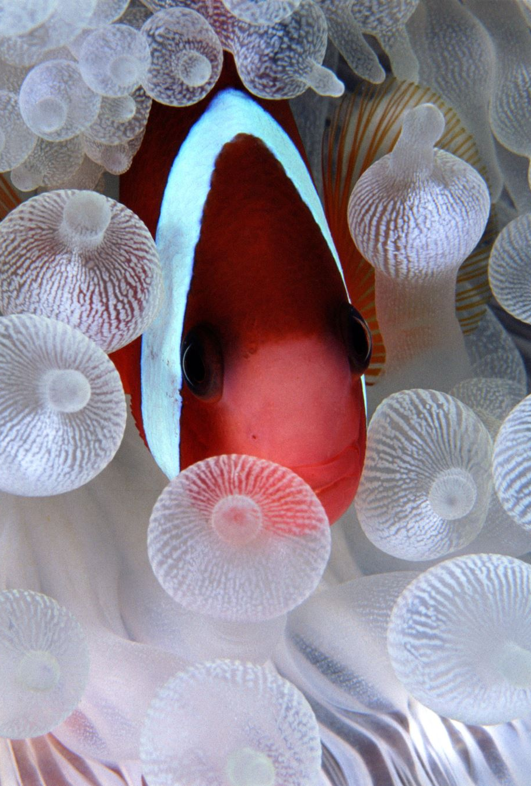
FIN

