Slide 1
CEiS 114 Course Project Traffic Controller
KaLEB bAKKEN

Slide 2

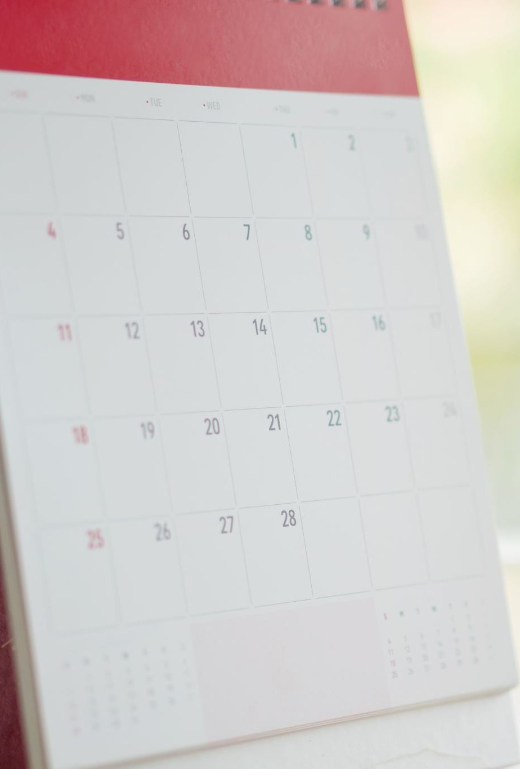
introduction
Over the last few weeks, we as a class had been developing systems such as traffic systems and rebuilding them on our breadboards and using Arduino to use coding provided and be able to replicate the traffic lights we see and use everyday.
Each week was a bit more challenging, especially this last week.

Slide 3
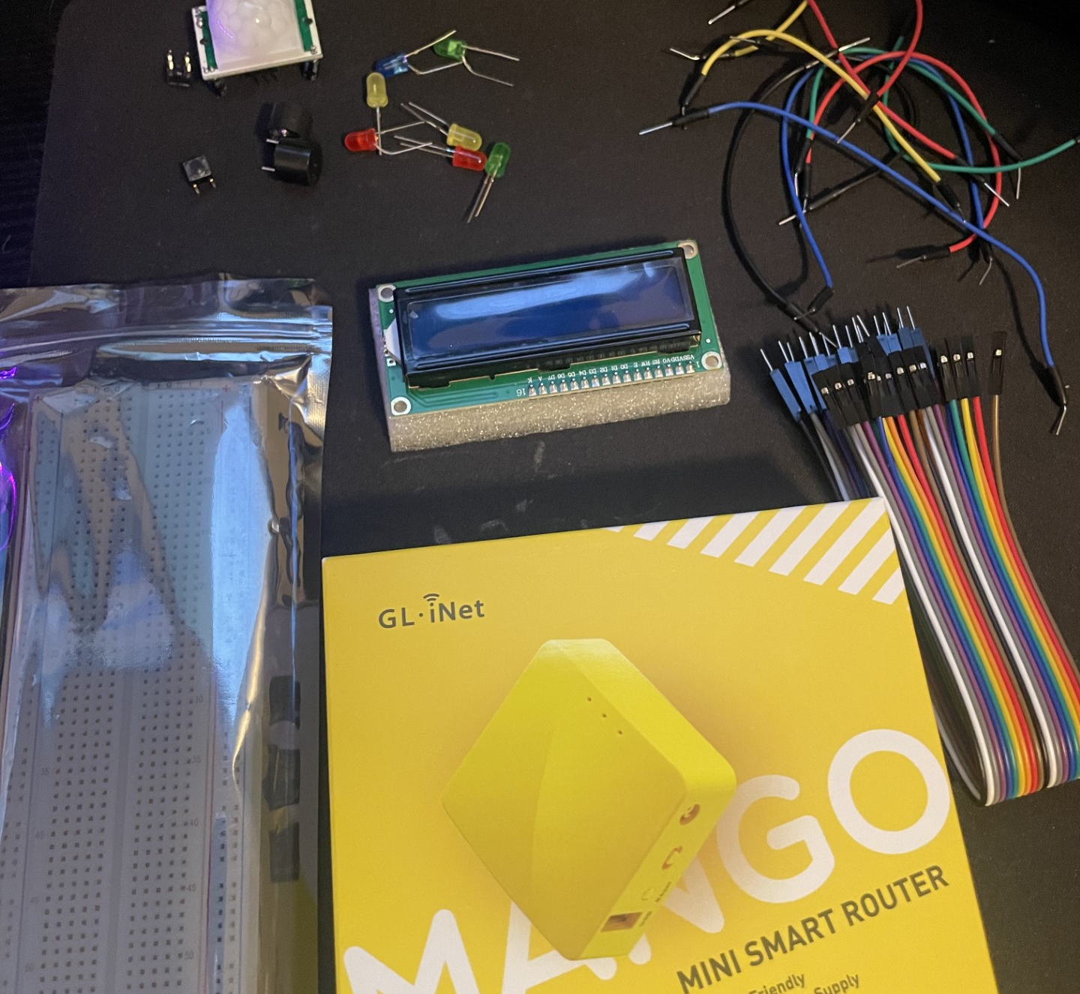
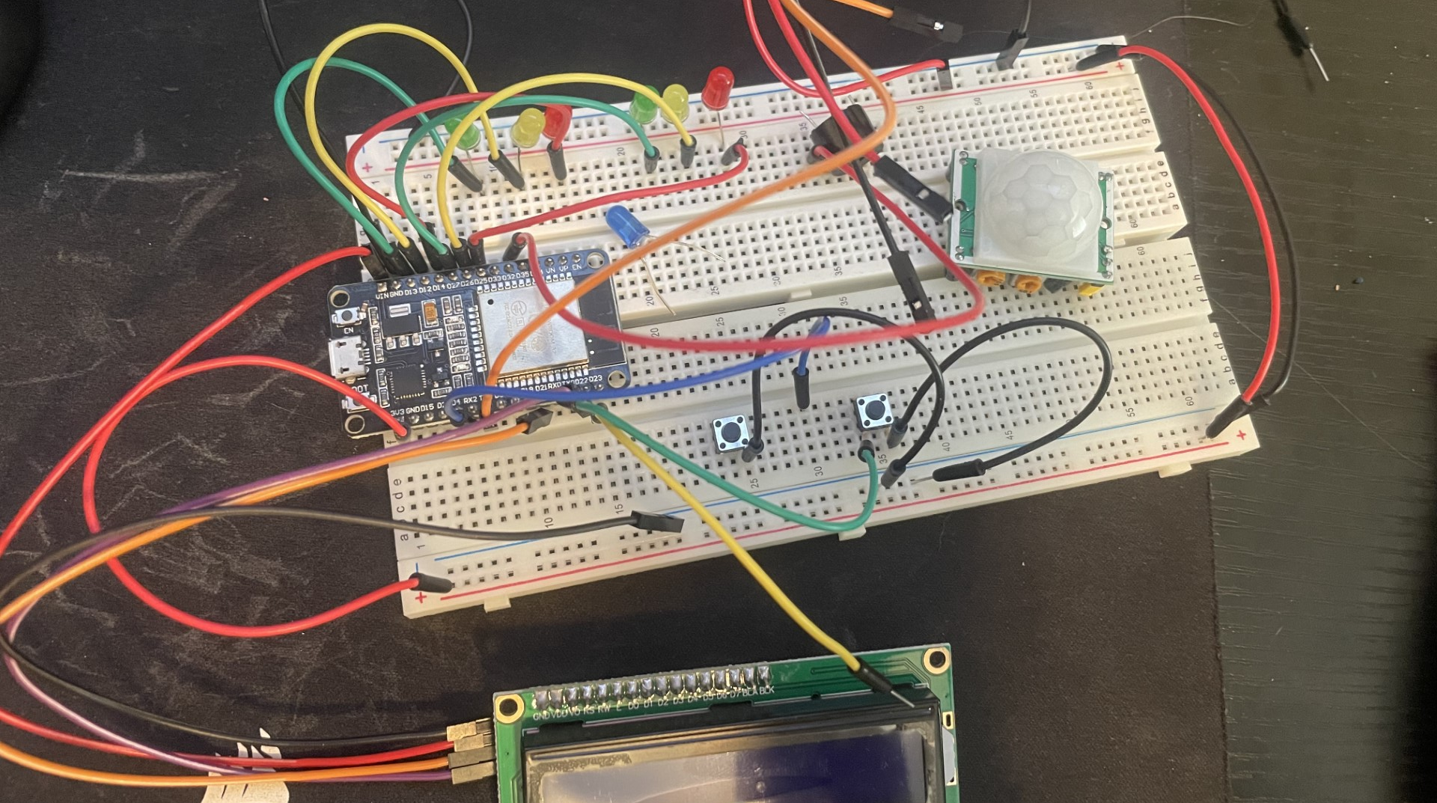
Project preparation
Over the weeks we have learned a lot about traffic systems and how to build them
Pictures to the left show the components we ended up using

Slide 4
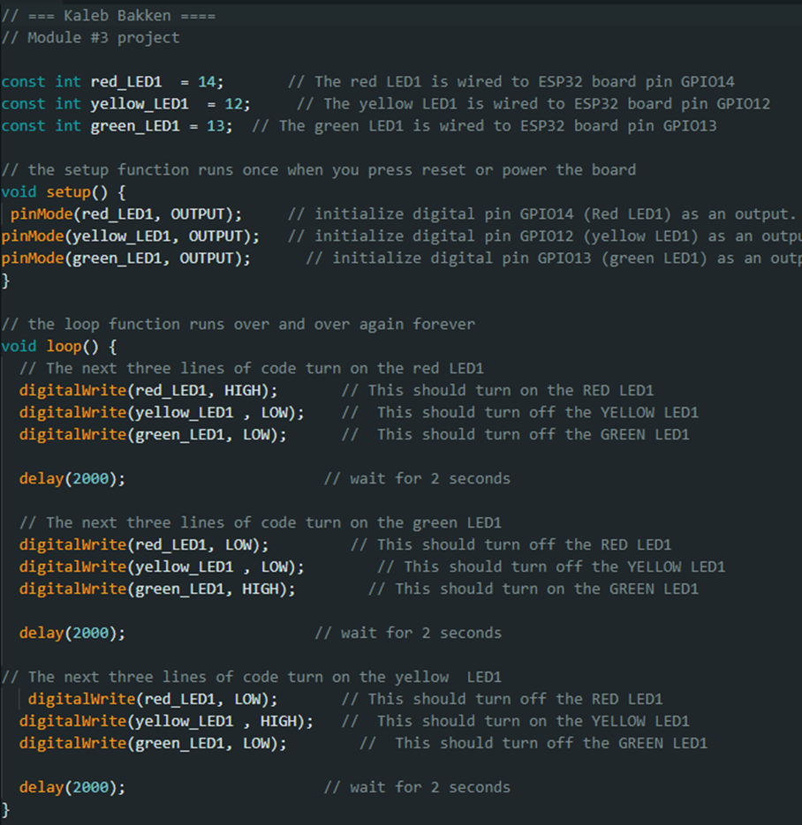
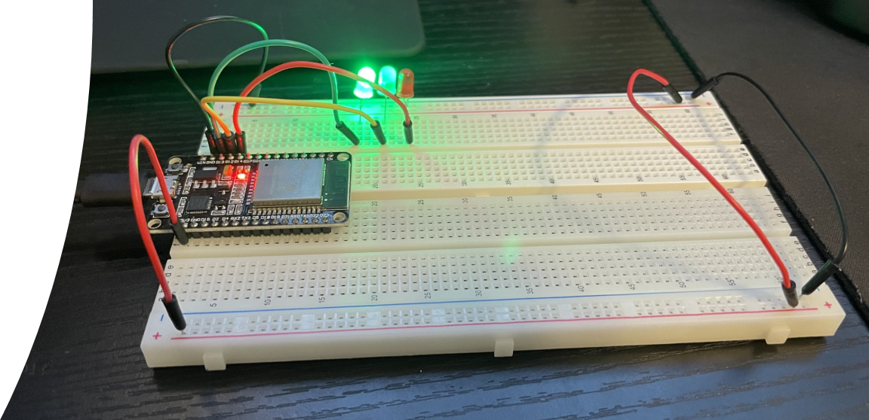
Creating a basic traffic light
We started out in the course with a basic traffic light to pretty much dip our toes in the water and understand a little bit more about how these devices work in our everyday lives
I provided the code we used and a sample of the photo I had taken of my board
As can see I used a green, yellow, and red LED for the lights, and connected those wires to the board as well as provided power and grounding so power can travel safely throughout the board using the code provided.

Slide 5
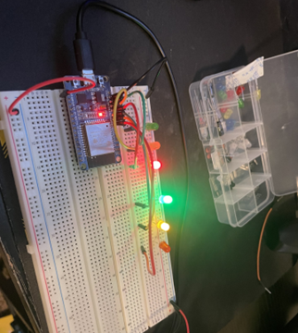
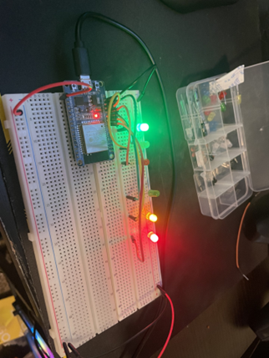
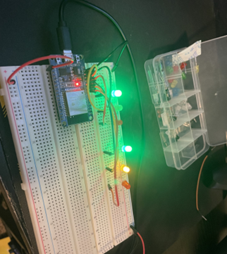
Creating a multiple traffic light controller
Week 4 was a fun one for me, I was able to successfully be able to put together a multiple light system with it being able to function as one group
As can see all I really did was add another set of LEDs and wires to the board.

Slide 6
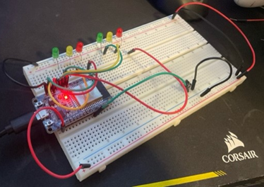
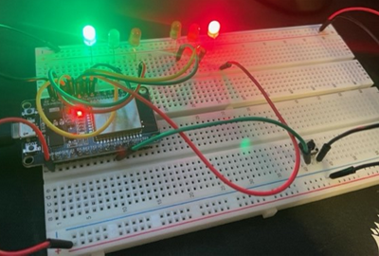
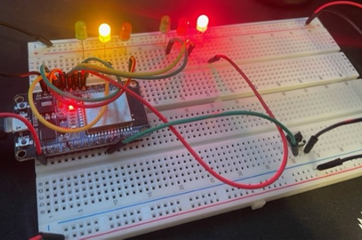
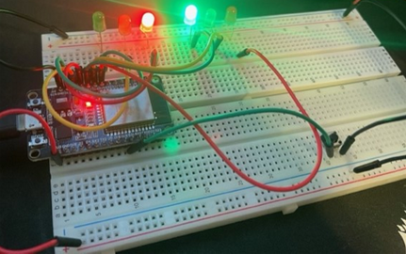
Multiple traffic light controller w/ Cross Walk P.1
This week we added a controller that would add in a button to stop the lights to represent a cross walk
What I did was add in a button and place in in the board, provide power to the button while adding in a ground and another wire for output.

Slide 7
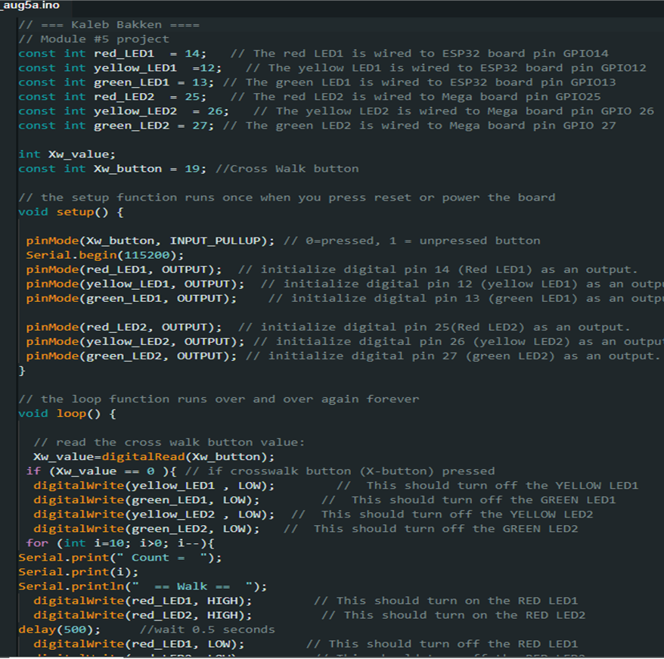
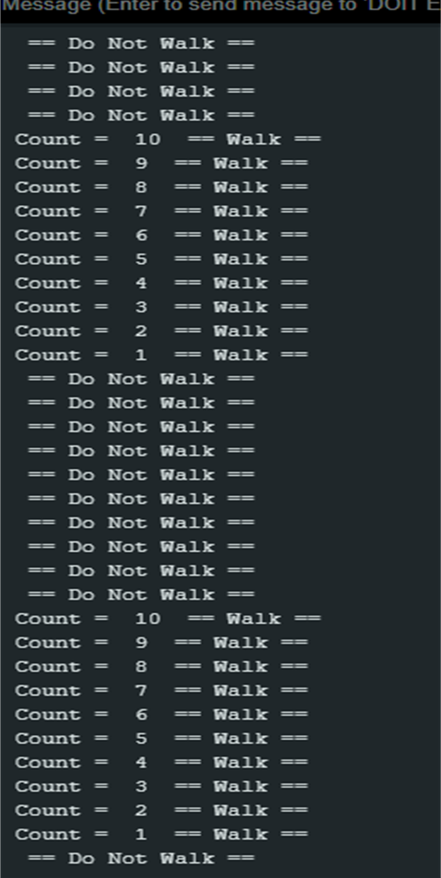
Multiple traffic light controller w/ Cross Walk P.2
I provided the code and serial monitor that was able to read the cross walk and provide the LEDs to switch lights when pressed.

Slide 8
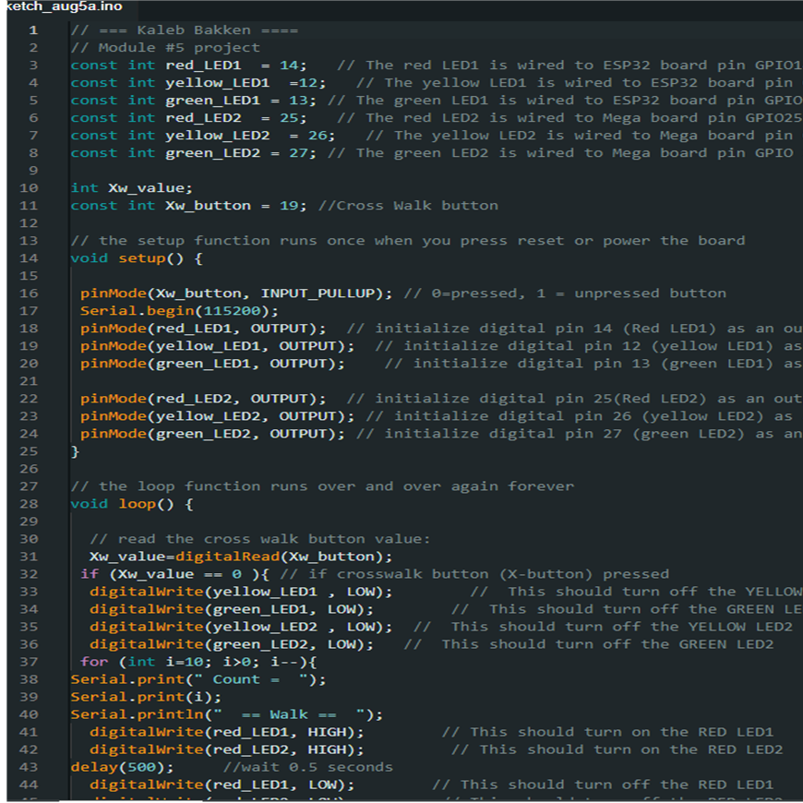
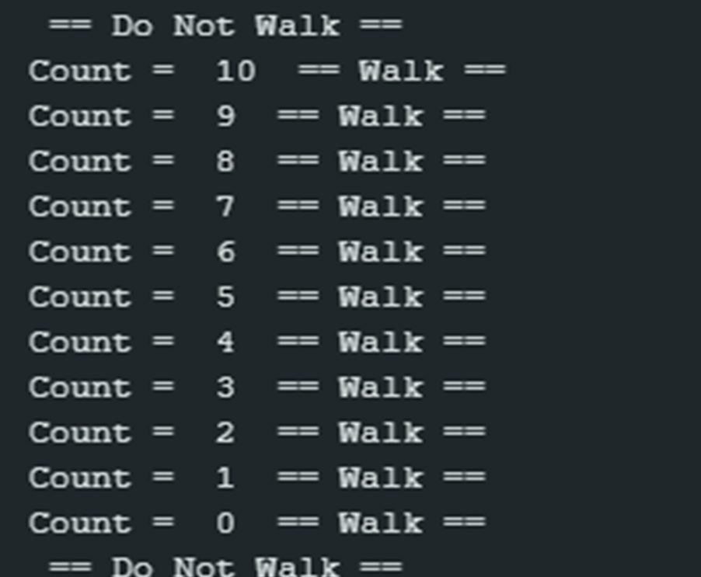
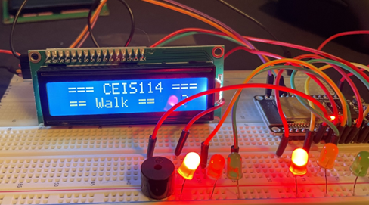
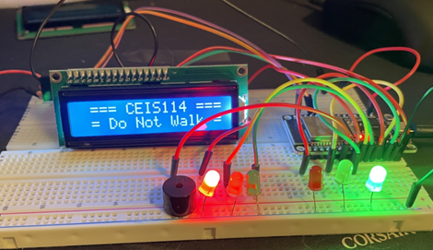
Multiple traffic light controller w/ Cross Walk and emergency buzzer and lcd
Overall, this one was my favorite to do even if I got stumped a bit along the way
We were able to add in a LCD to add in a visual aid along with the previous worked projects adding into one system

Slide 9
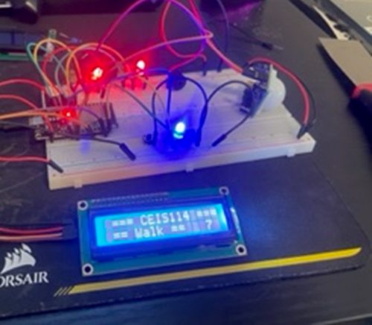
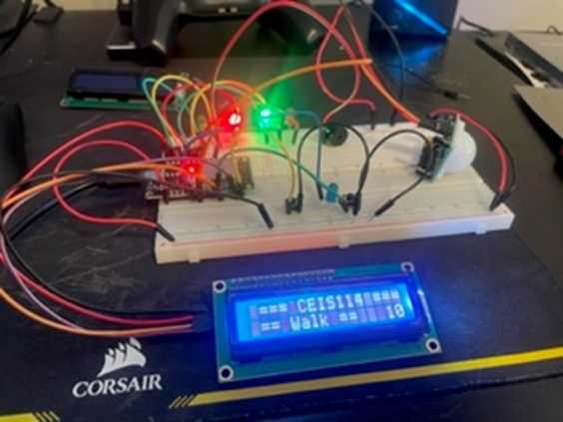
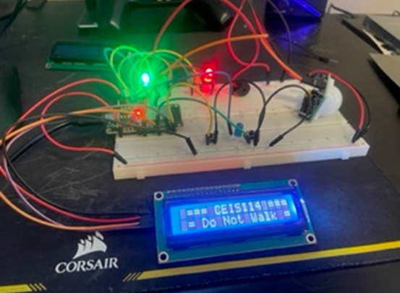
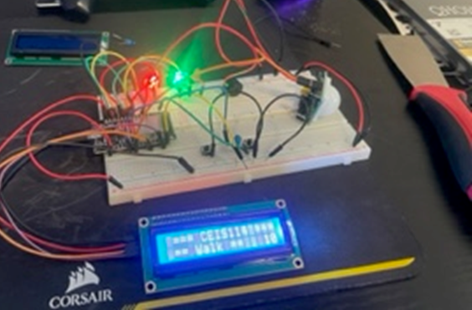
Creating a Multiple Traffic Light Controller with a Cross Walk and an Emergency Buzzer with SMART sensor P.1
Now this one was one of the hardest projects I have done so far.
I added an emergency button and motion sensor to the already built traffic system, and was able to add a button to signify and emergency switch to use for like fire trucks needing immediate passing.

Slide 10
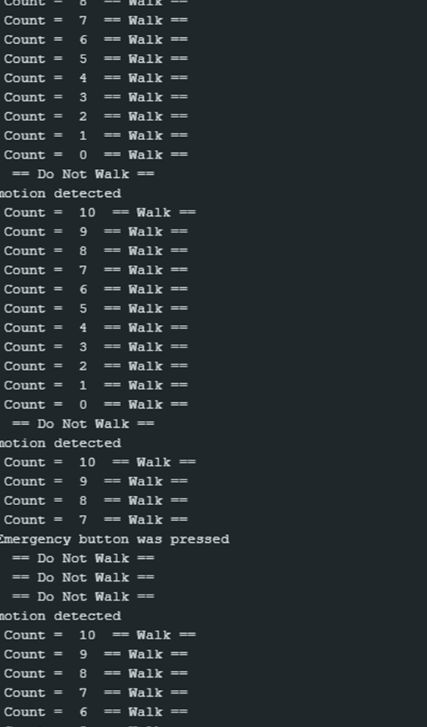
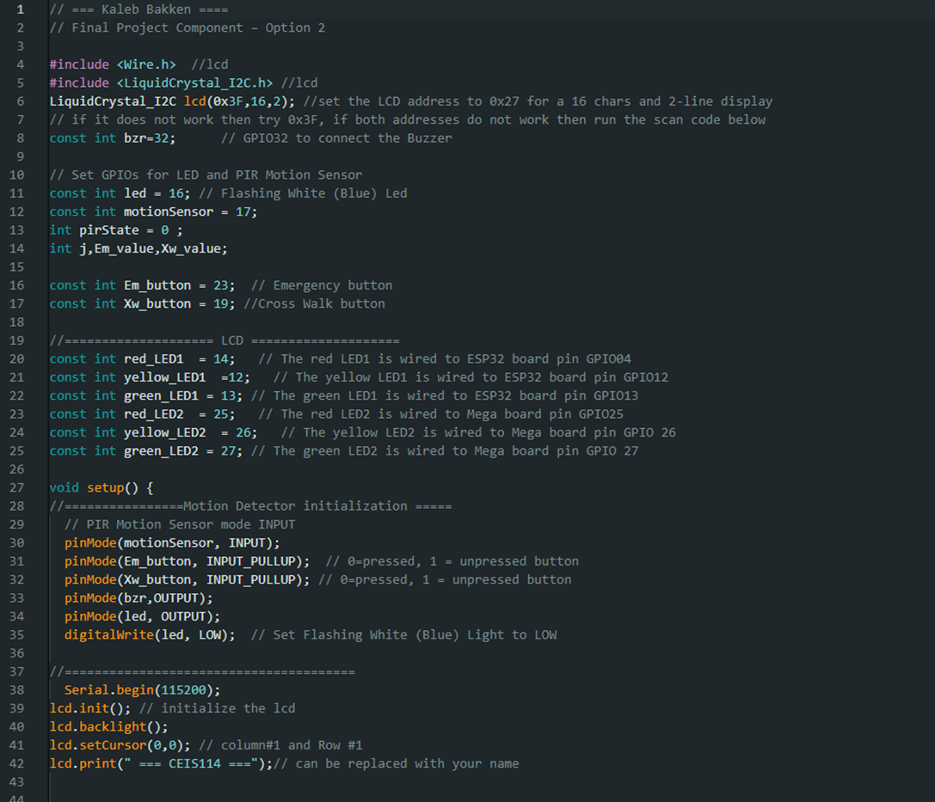
Creating a Multiple Traffic Light Controller with a Cross Walk and an Emergency Buzzer with SMART sensor p.2
Here I provide the coding I used and what the serial monitor picked, and as you can see the motion detector worked and switched the lights when it detected any kind.

Slide 11
Conclusion
Overall, this course was a blast, I am a team player, but I tend to work by myself and been working on that and this course helped in a bit. I can work with others but when it comes to my pride, I want to show I can hold my own
Only problem I ran into was the final course project, due to not only a few wires being faulty but having an LCD display being faulty and both buttons being faulty, and I just got frustrated and frustrated for 2-3 day, and I always just took a step back to trey to calm down to find out a reason.
Ended up asking a classmate to see what they did and investigated the discussion portion to see if others had problems.
Was a fun and enjoyable course though!

